Slide 1
Impact of Technology on Infrastructure Management
Yogesh Patel
Group Process & Improvement Director

Slide 2
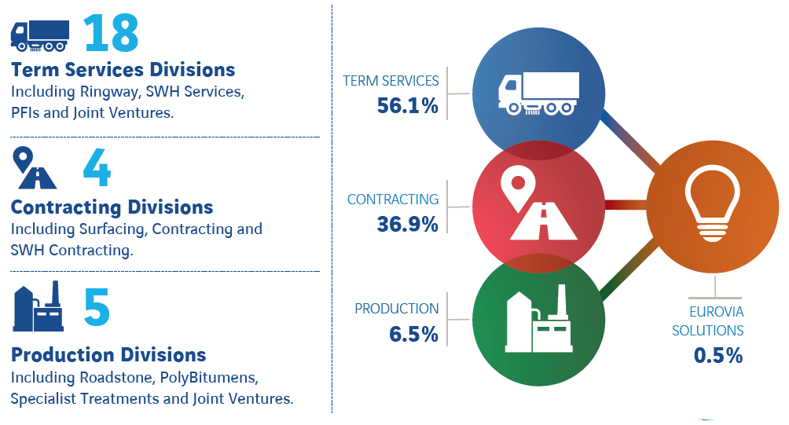
Eurovia UK
Including Ringway, Ringway Jacobs, BEAR Scotland and SWH
56%
Road & Public Realm Contracting
and Surfacing
37%
7%
Bitumen, Emulsion & Asphalt Production and Specialist Treatments

Slide 3
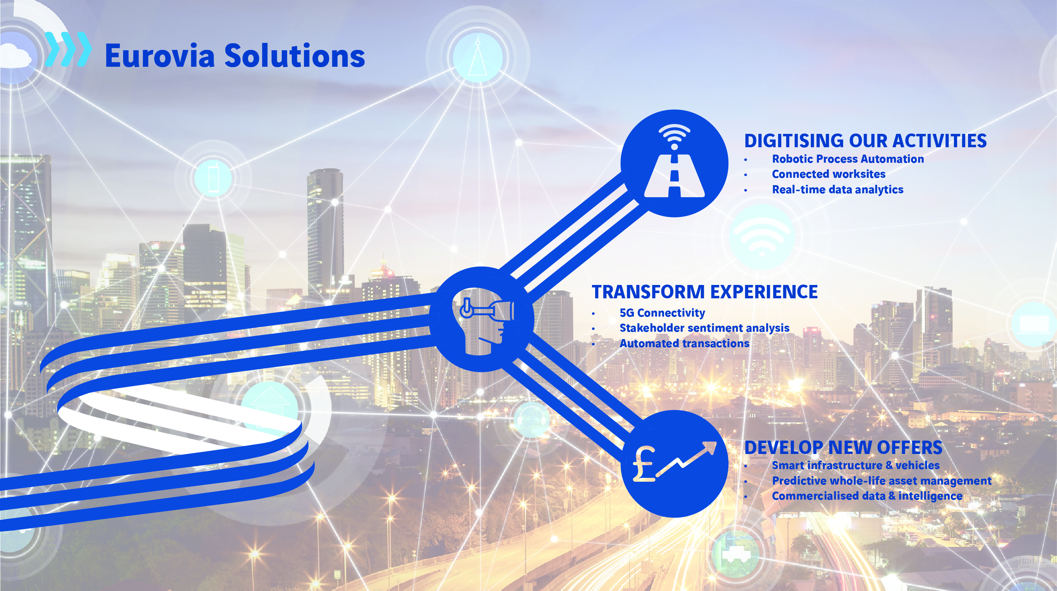

Slide 4
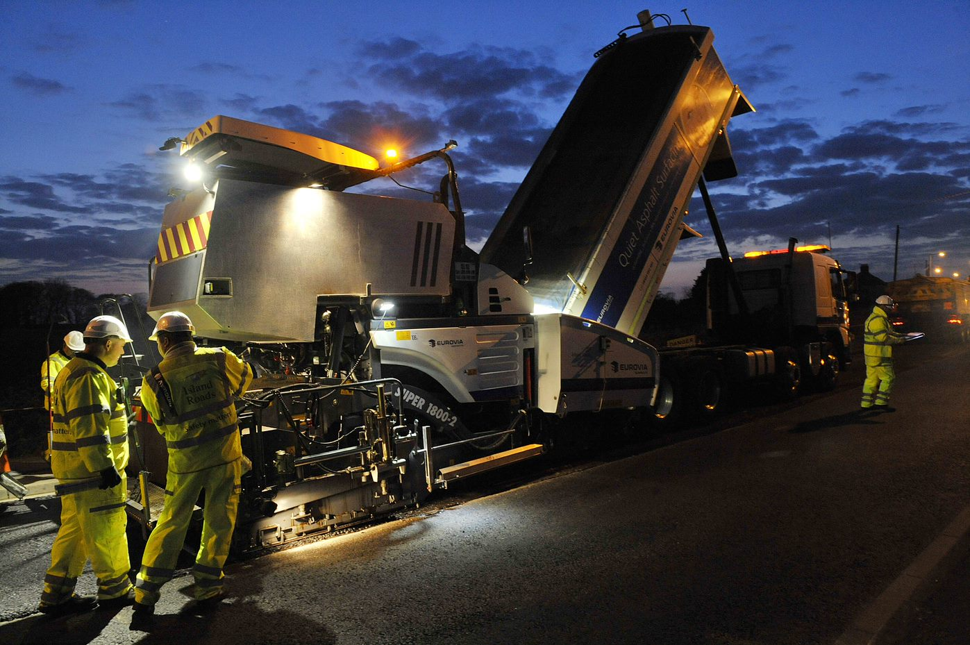
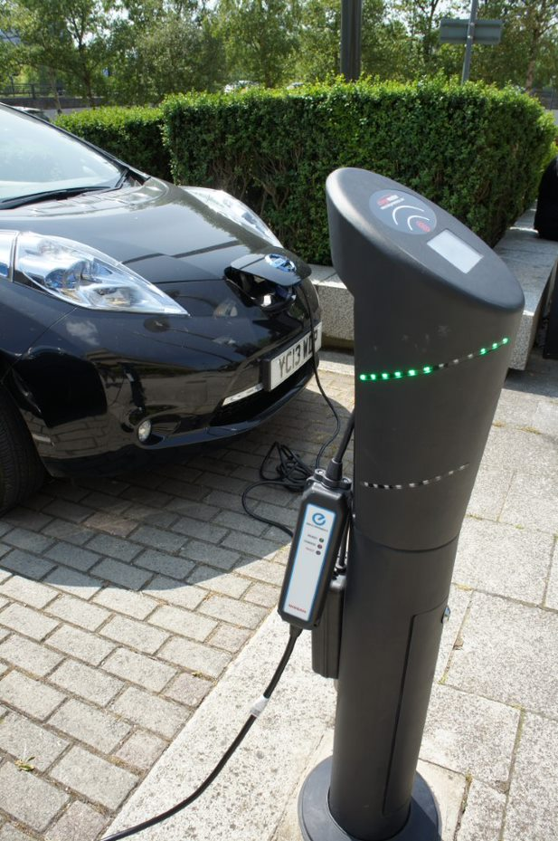
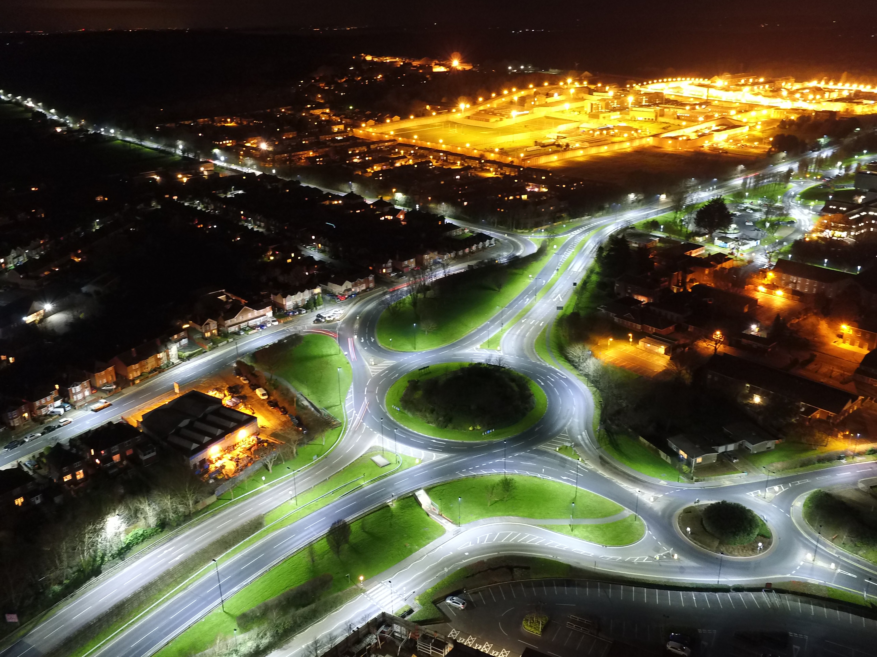
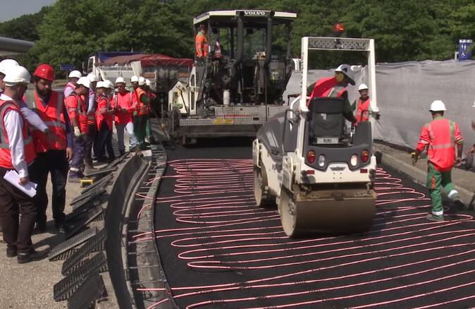
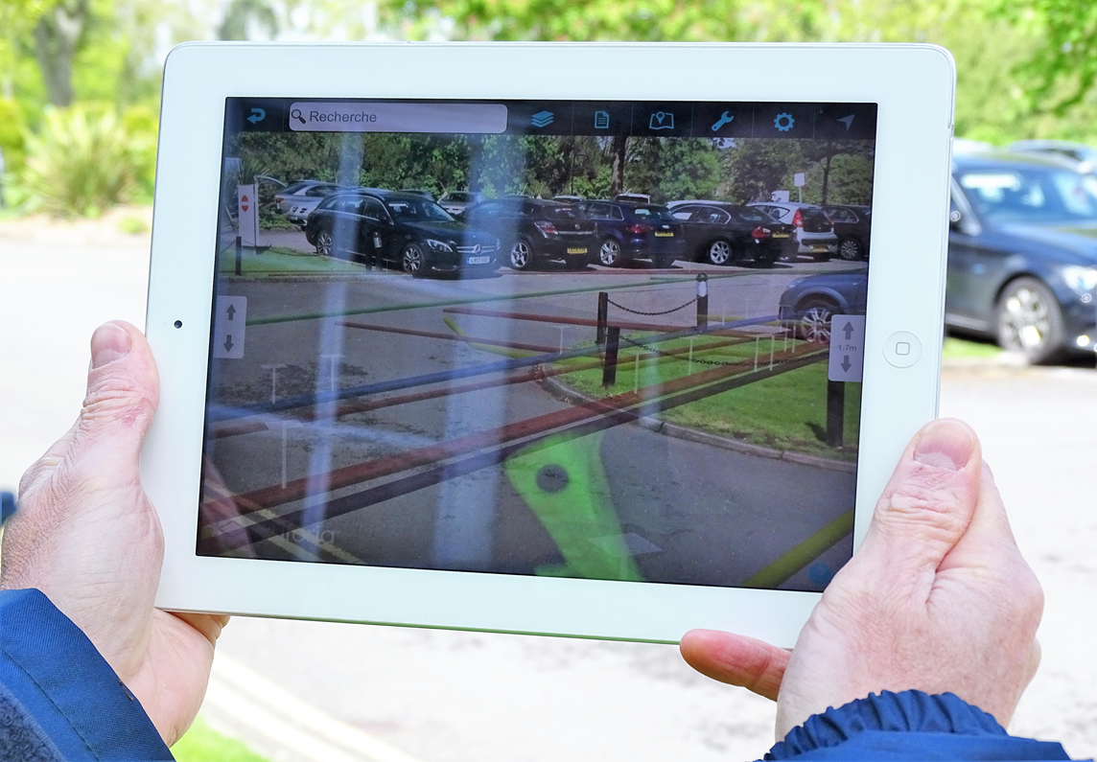
CORE THEMES
1) Innovation & Emerging Technology
2) Connected & Autonomous Vehicles
3) Highways in the Future
4) Business Models & Funding

Slide 5
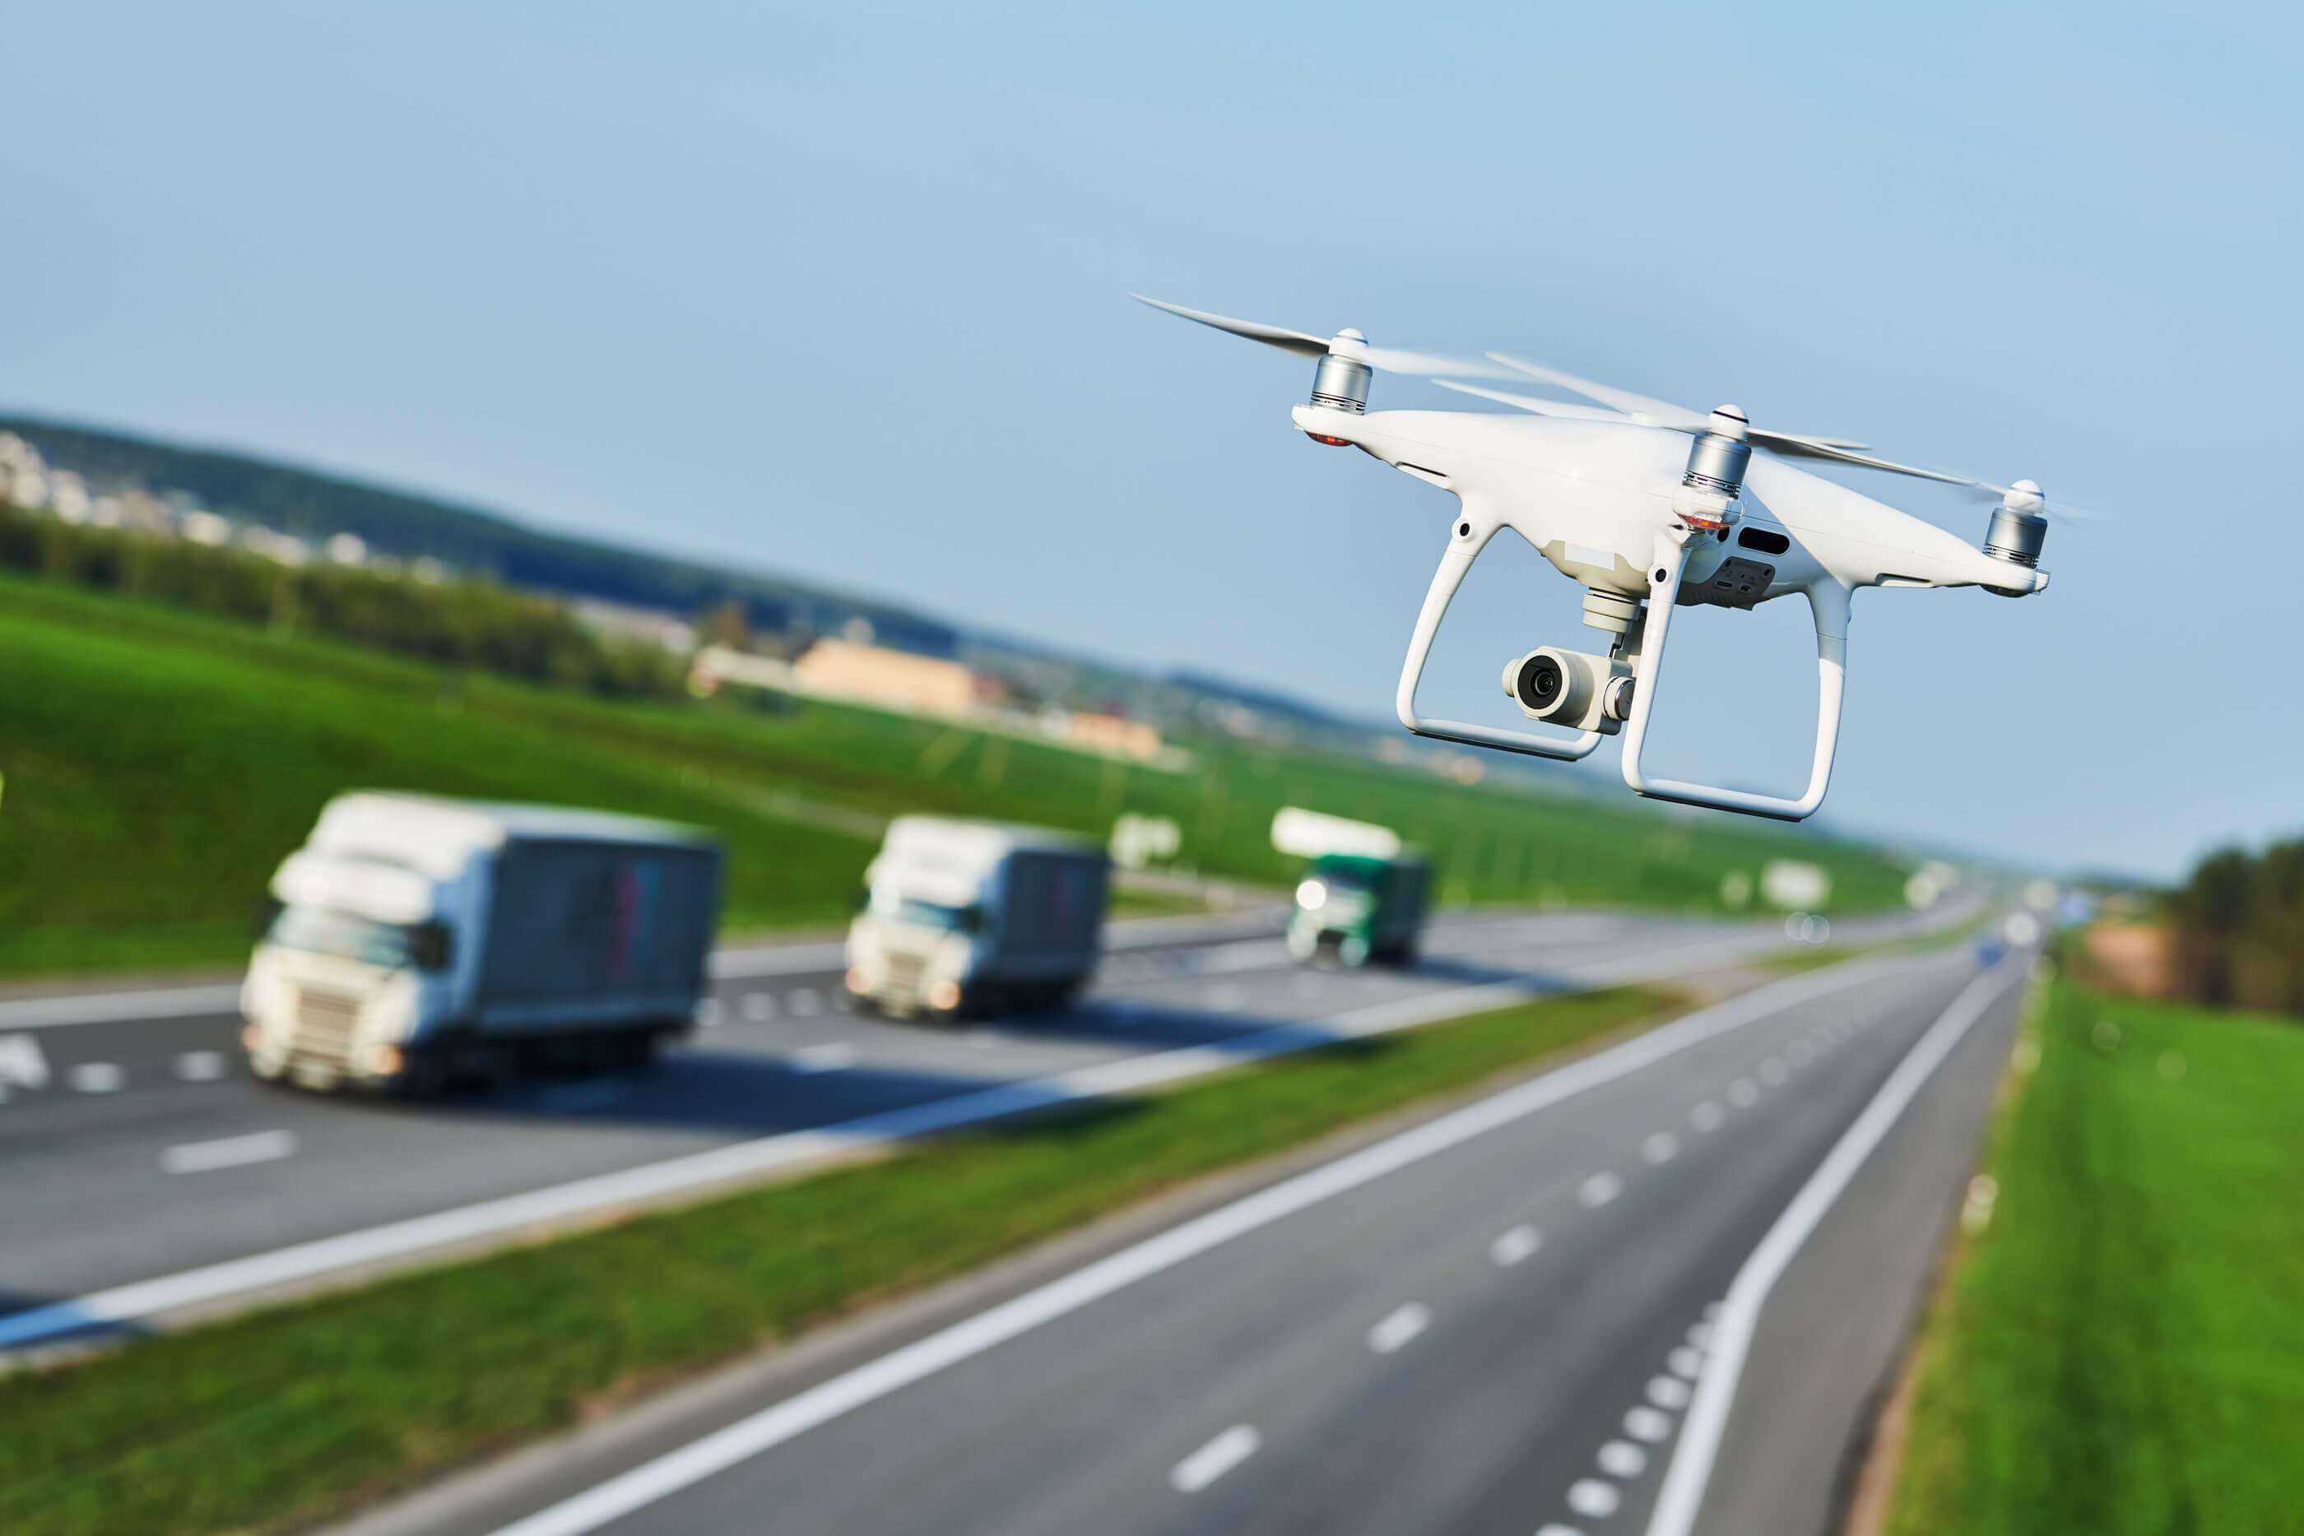



Innovation & Emerging Technologies
Artificial Intelligence
Machine Learning
Big Data
Internet of Things
3D Printing
Drones
Robotics
5G
Blockchain
???
Notes:
Artificial Intelligence
Machine Learning
Big Data
Internet of Things
5G

Slide 6
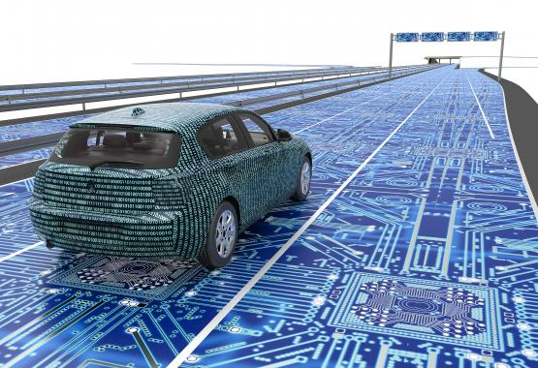
Connected & Autonomous Vehicles
Notes:
Connected Vehicles & Smart Infrastructure
Interfacing and interoperability between people, vehicles and infrastructure
5G embedded within assets
Interfacing and interoperability between people, vehicles and infrastructure
5G embedded within assets

Slide 7


Notes:
Highways in the Future
Highways are no longer just about travel – they will assume a hybrid function
Corridors for the generation and transfer of energy
Hubs for connectivity – interoperability between users, vehicles and assets
Travel is no longer about simply getting from A to B
Focus on mobility and the ‘customer experience’

Slide 8
Traditional Business Model
Highway Authority
Public
Contractor
Supplier
Notes:
Business Models & Funding
Commercialisation of data collected by assets
Joint ownership of roads
Concession model for network transformation
A broader scope of partnerships
Decline in VED and fuel duty revenues as vehicles become green
Tax on journeys as opposed to vehicles and road use
Should we ‘book a place’ on the network?
This should all be considered in the context of Mobility as a Service (‘MaaS’) overtaking singular ownership of vehicles

Slide 9
Future Business Model
Personalised Service
Crowd Voting
Crowd Funding
Taxation Models
Shared Ownership of Assets
Extracting Value from Highway Assets
  Energy
  Connectivity & Data
  Mobility
  Water
Digital Partner
Supplier
Public
Highway Authority
Contractor
Notes:
Business Models & Funding
Commercialisation of data collected by assets
Joint ownership of roads
Concession model for network transformation
A broader scope of partnerships
Decline in VED and fuel duty revenues as vehicles become green
Tax on journeys as opposed to vehicles and road use
Should we ‘book a place’ on the network?
This should all be considered in the context of Mobility as a Service (‘MaaS’) overtaking singular ownership of vehicles

Slide 10

Créer votre prochain mouvement

