Slide 1
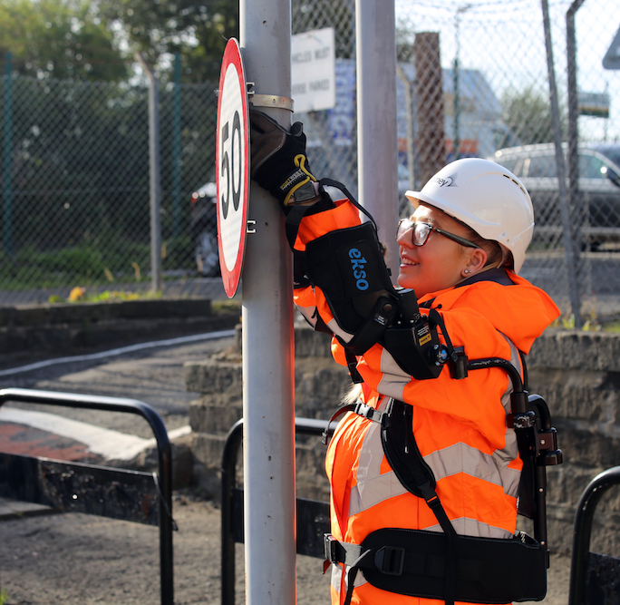
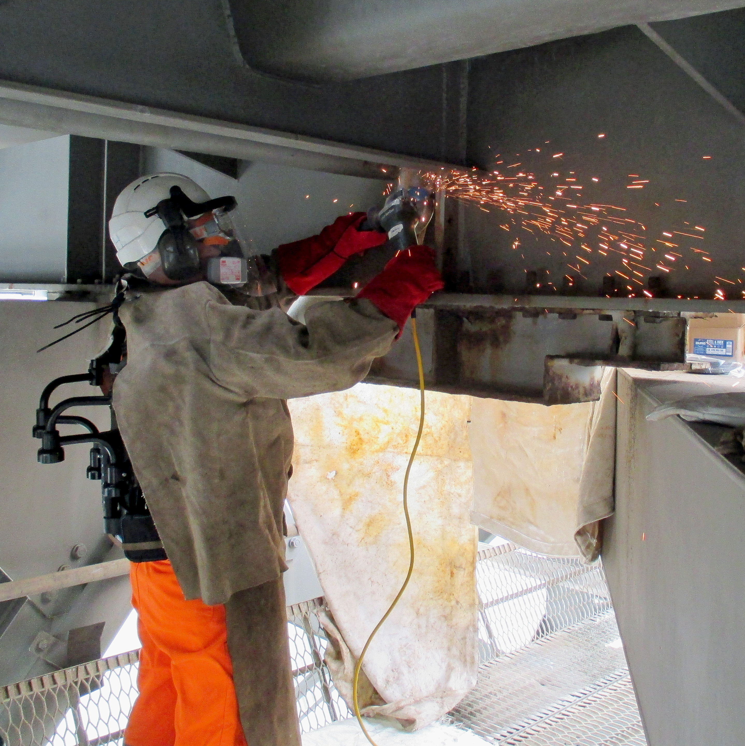
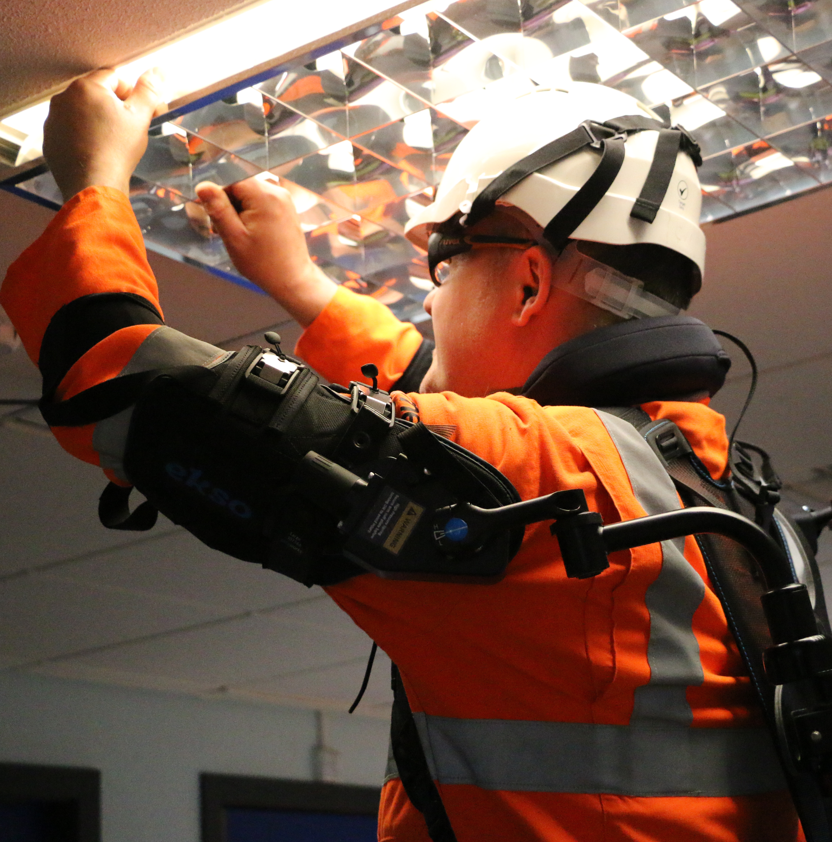
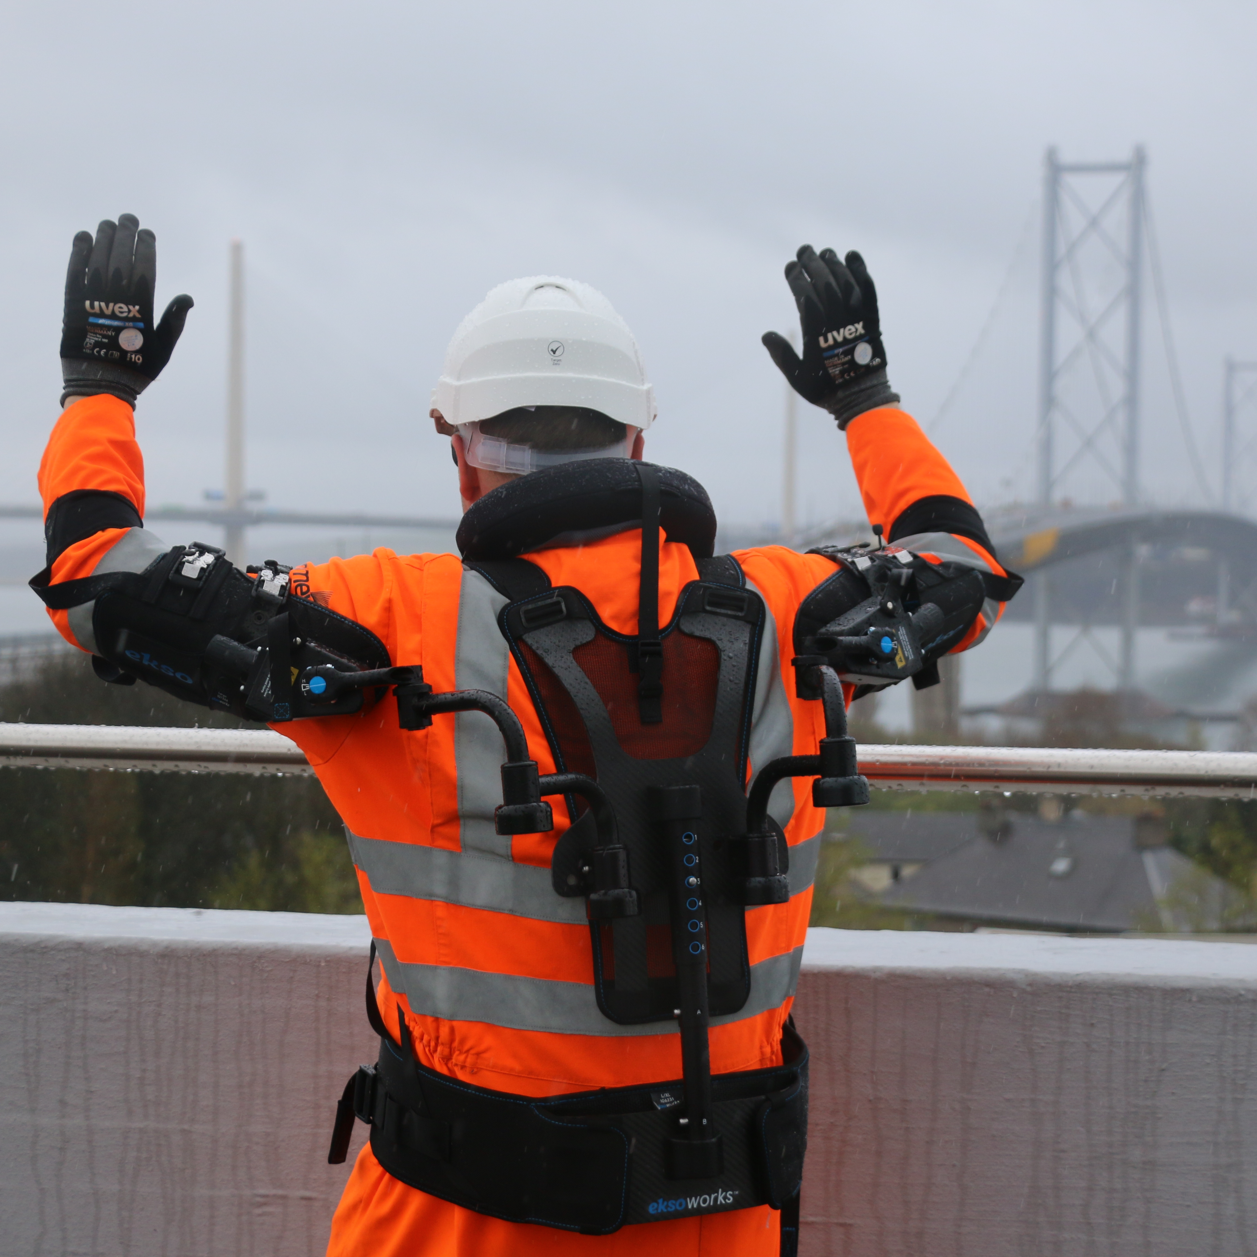
Innovative safety solutions
Putting people first
Vision 2030
Amey has a vision: to eliminate the potential for harm on our highways and across the industry.
We can only do this through collaborative innovation – putting the automation of highways activities at the heart of what we do. We are acutely aware of the vital role the network performs and the importance of working collaboratively with our supply chain, competitors and clients to achieve this.
By looking across at other industries that are different to the sector we operate in, we can use best practice and innovative solutions to harness the rapid advancement of technology to use automation and digital options to deliver services differently and eliminate the potential for harm to our people.
The EksoVest solution
The EksoVest is an exoskeleton solution, developed by J&J Tooling for the car manufacturing industry. The solution is an innovative robotic exoskeleton where springs kick in when arms are lifted to chest height, giving up to 6.8kg of lift assistance per arm.
The EksoVest has been trialled with Amey’s teams at the Forth Road Bridge to understand whether we can integrate the technology into everyday tasks to reduce fatigue.
“The vest takes the strain off my back when I’m doing heavy lifting – I really feel less tired at the end of the day.”
“It takes the strain off overhead work like welding and painting and helps when installing underdeck staging.”
“It’s light and comfortable to wear and doesn’t restrict your movement.”
“The process is more efficient and delivers improved productivity.”

