Slide 1
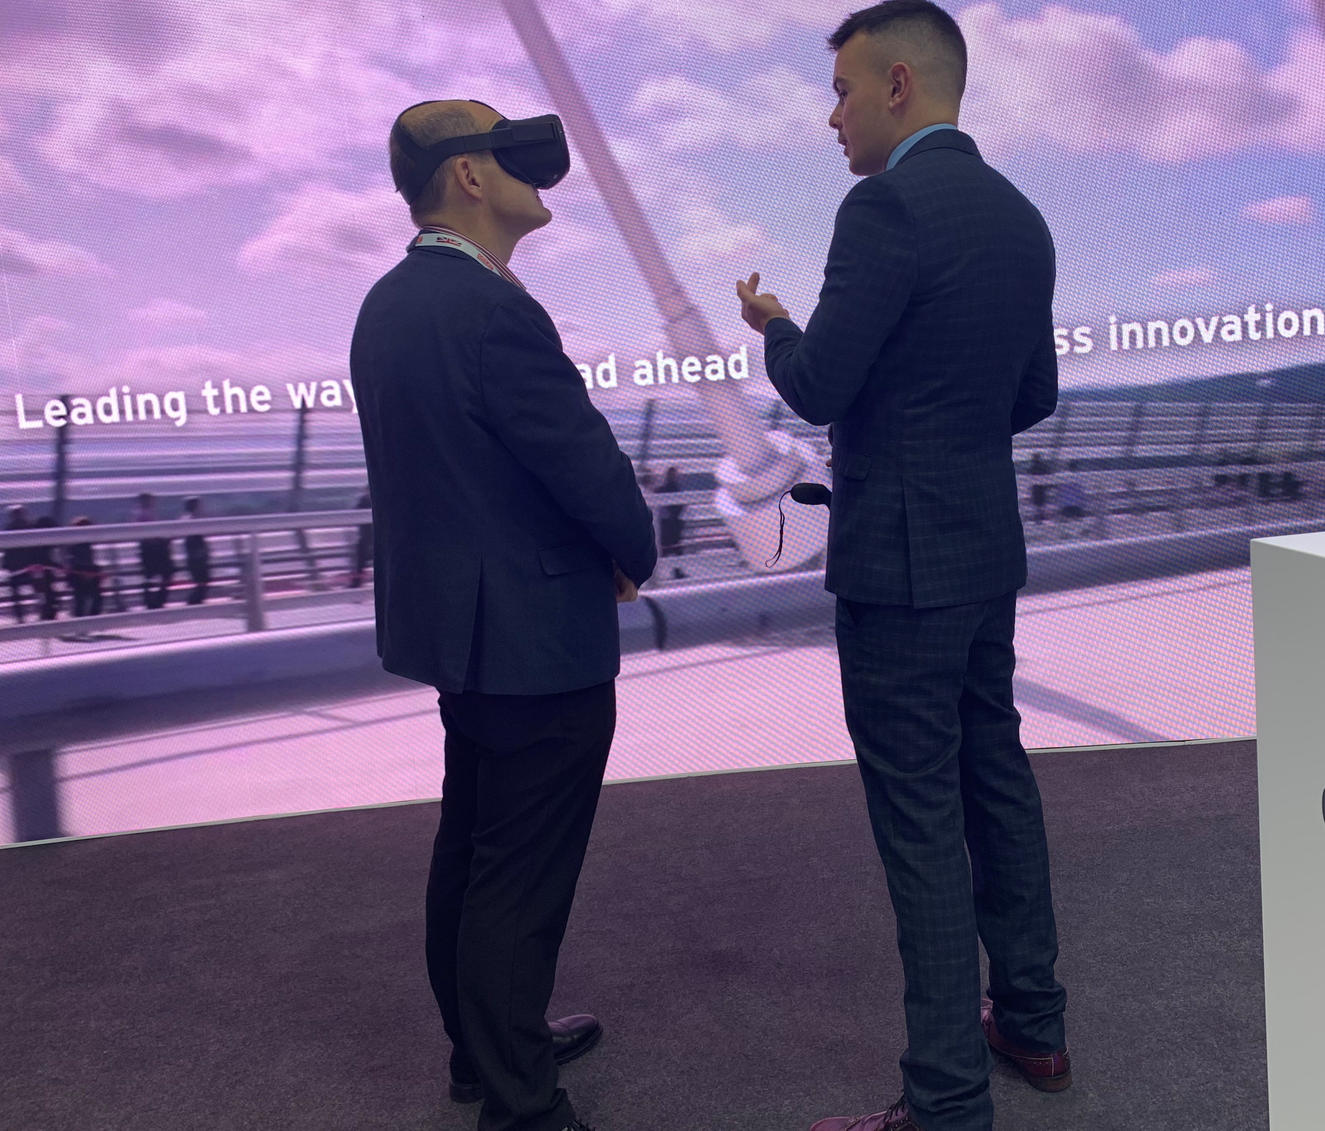
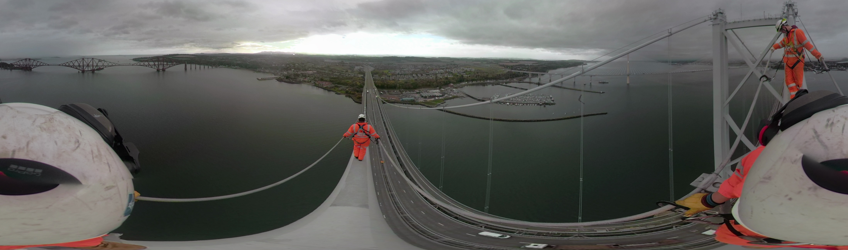
Improving safety with Virtual Reality
Creating better solutions
Vision 2030
Amey has a vision: to eliminate the potential for harm on our highways and across the industry.
We can only do this through collaborative innovation – putting the automation of highways activities at the heart of what we do. We are acutely aware of the vital role the network performs and the importance of working collaboratively with our supply chain, competitors and clients to achieve this.
By looking across at other industries that are different to the sector we operate in, we can use best practice and innovative solutions to harness the rapid advancement of technology to use automation and digital options to deliver services differently and eliminate the potential for harm to our people.
Amey maintains the Forth Road Bridge on behalf of Transport Scotland. The Amey team have unique challenges with this environment, working 60 metres above the Forth of Firth in cold, wet, windy weather for much of the year. Safety is always their priority. Virtual reality solutions enable us to put individuals in realistic solutions without exposing them to this risk.
We use a GoPro to capture footage of common working scenarios on the bridge. Voice commentary and overlaid checklists then support users in understanding and assessing the risks they are seeing.
Users experience the scenarios using VR headsets and interact with the environment with a handheld controller.
The Forth Bridge team have recorded 360 videos of the bridge main cable route which is then used for the induction of new employees, showing the safety harness arrangements and giving experience of the site and the dangers involved with working at height, without safety risks.
The team have also seen positive feedback from using virtual reality as an engagement tool with key stakeholders and to bring some danger-free excitement to educational visits.

