Slide 1
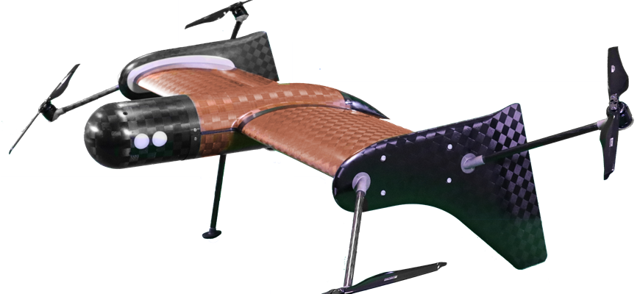
AmeyVTOL
Creating better solutions
AmeyVTOL set to revolutionise robotic data capture from the skies
AmeyVTOL has successfully won funding from Innovate UK under the Small Business Research Initiative (SBRI) for a project to collect real time data from railway infrastructure with Network Rail.
AmeyVTOL’s unique long range hybrid drone, known as The Flying Wing, can fly on up to 100km missions and has built in leading edge sensor technology. This means AmeyVTOL can use artificial intelligence to process data and provide automatic defect detection – allowing the engine room to make decisions ‘from the sky’. The ground breaking drone is not only efficient and low noise but also has the ability to generate digital asset models.
AmeyVTOL is a joint venture between Amey and VTOL technologies, an SME which develops breakthrough aerial robotics.
Run by Innovate UK and funded by the DfT to support research, development and innovation in the UK rail industry, the competition for funding seeks innovative ideas that can be adapted to transform rail travel.
The bid for funding presented the intention of flying and operating a drone beyond visual line of sight, which means carrying out asset and track inspections from the skies, removing workers from harm at the side of the rail network.
For more information on the Innovate UK funding projects visit:
https://www.gov.uk/government/news/78-million-to-drive-forward-innovative-ideas-to-transform-railways

