Slide 1
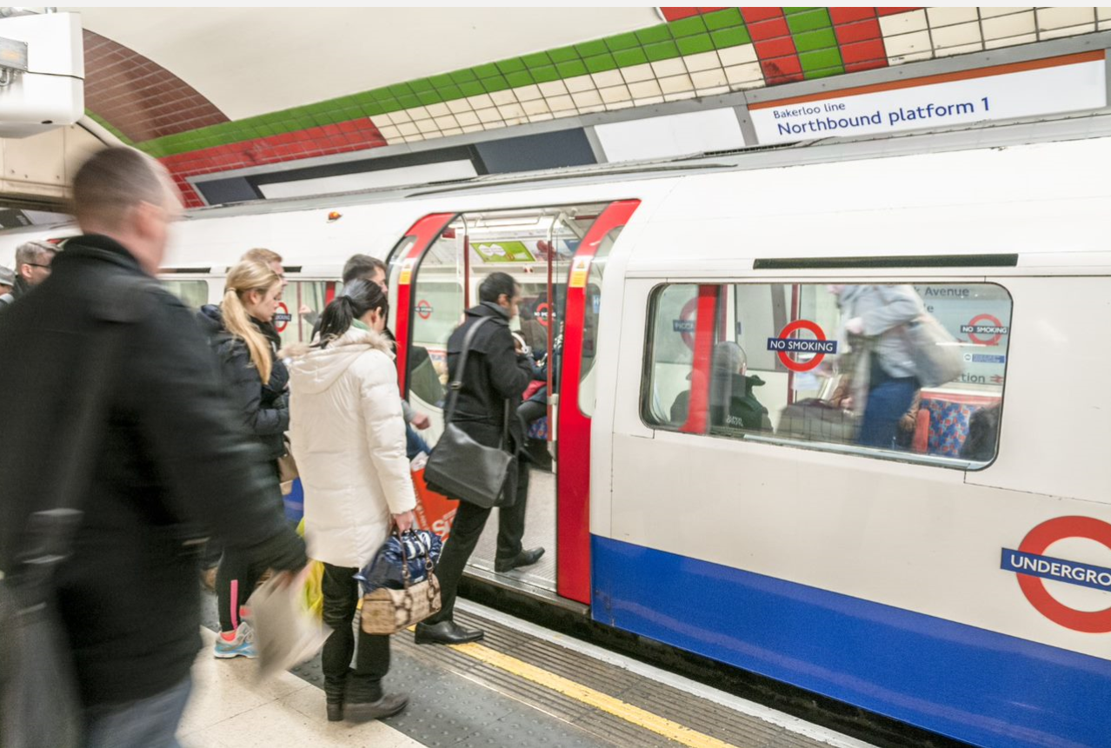
Cosmo Quartz
Creating better solutions
Summary
Cosmo Quartz involves helping Train Operating Companies through Network Rail improve performance using data. Amey’s Strategic Consulting team has created an innovative web-based station dashboard called Quartz to help Train Operating Companies reduce train delays. Quartz combines multiple real-time datasets to empower station managers to build an intelligent profile of their stations which allows them to plan and react quickly when a problem occurs.
Using Quartz, station managers can see exactly when a train arrived and left the platform. The information is so precise that it shows the time the wheels on a train stopped (on arriving at the platform) and when the wheels started again (at leaving the platform). The information is then summarised to show which trains are doing well and those doing badly.
Deliverables
40% reduction in delays within the first month of deploying Quartz
Unique and user-friendly software helping train operating companies to improve train performance
First of its kind
Measured against the number of improvement actions given to users of the dashboard
What has worked well
Train operating companies can immediately record a reason for a delay (i.e. too many passengers) which subsequently helps in identifying the most common reasons and find solutions.
Social Value delivered
Quartz has helped improve station staff satisfaction by making them more aware of what their jobs involve
Passenger satisfaction through immediate improvements in service levels and reduction in delays
Best Practice
Going beyond finding a solution and showing how to resolve by involving the user in the solution-finding process
Combination of technical staff
Ensuring the product/service makes a difference to the end user
Euan Wakenshaw | Station Customer Service Assistant
"The Quartz tool has helped immensely by allowing us to directly pinpoint the reasons for delays, allowing managers to attribute delays away from the station. We’ve also been able to see when our problem times of the day have been and step up our service as needed. I’ve also been able to use the information provided to create a more visual guide to performance which I believe is more engaging for staff."

