Slide 1
Business models for
Electric Road Systems – heavy vehicles
Swedish ERS program
World Road Association (UK) Congress 2018 Cardiff
15 November 2018
Björn Hasselgren PhD

Slide 2


Climate related objectives and visions
Paris agreement
“Sweden will become one of the world’s first fossil-free welfare societies”
Vehicle fleet independent of fossil fuels by 2030
  Interpreted as reduction of emission of CO2 with 70% compared with 2010 (Parliamentary Cross-Party Committee proposal)
Notes:
The Paris Agreement’s central aim is to strengthen the global response to the threat of climate change by keeping a global temperature rise this century well below 2 degrees Celsius above pre-industrial levels and to pursue efforts to limit the temperature increase even further to 1.5 degrees Celsius. The ultimate objective of the Convention is to stabilize GHG concentrations “at a level that would prevent dangerous anthropogenic (human-induced) interference with the climate system”. It also states “such a level should be achieved within a time frame sufficient to allow ecosystems to adapt naturally to climate change, to ensure that food production is not threatened, and to enable economic development to proceed in a sustainable manner”.
Sweden aims to become one of the world’s first fossil-free welfare countries. Emissions will be reduced at the rate necessary for globally sustainable development. The transition must be effective and provide long-term rules. The long-term climate goal means that by 2045 at the latest Sweden will have no net emissions of greenhouse gases, according to a proposal by the Parliamentary Cross party committee. In more precise terms, the long-term climate goal means that emissions from activities on Swedish territory will be cut by at least 85 per cent compared with emissions in 1990. To achieve net zero emissions, flexibility measures can be included.
By 2030 Sweden shall have an vehicle fleet that is independent of fossil fuels by 2030. This in interpreted as an reduction in emissions from the domestic transport sector (not including domestic air travel) of at least 70 per cent by 2030 compared with 2010.

Slide 3
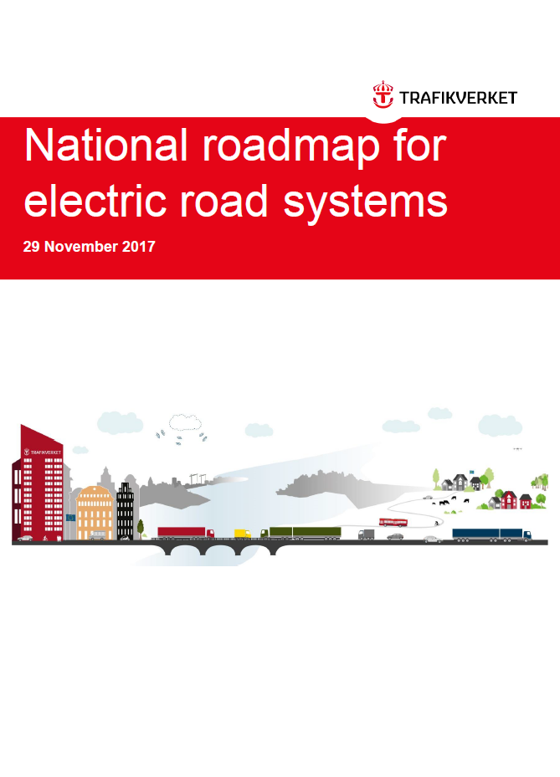
National roadmap for electric road systems in brief
Market and funding
Promote, contribute to and pave the way for a broadened market and greater competition between the transmission systems by raising more systems to TRL level 5-6.
Prepare and implement a major electric road system pilot
Create a long-term plan for the construction and development of electric road systems
Trafikverkets färgpalett
RGB: 213-43-30
RGB: 0-115-176
RGB: 254-203-0
RGB: 168-180-0
RGB: 146-139-129
RGB: 233-131-0
RGB: 143-202-231
RGB: 177-148-1
RGB: 206-214-75
RGB: 203-199-191
RGB: 167-25-48
RGB: 0-65-101
RGB: 91-73-31
RGB: 85-96-28
RGB: 54-53-52

Slide 4
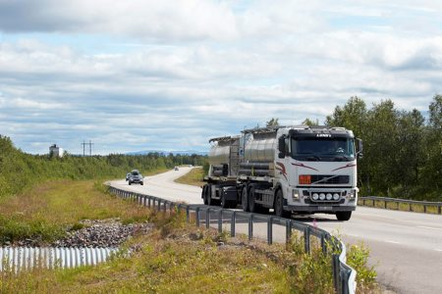
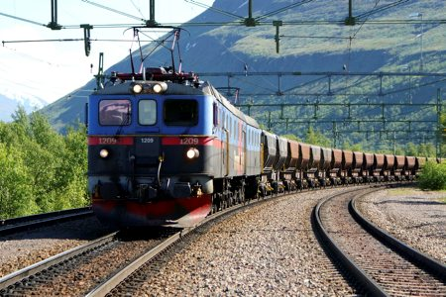
Freight transport in Sweden
65% of the land-based annual performance (tonnekm) on roads.
2/3 of this freight is concentrated to a few major roads.
An average transport on road is about 100 kilometers.
Public funded roads 217 000 km
35% of the land-based annual transport performance (tonnekm) by rail (EU average 17%).
Primarily long distances and very heavy transports
Rail capacity is limited and constrained
Public funded railroad 14 100 km
Notes:
The transport system should be considered as one integrated system. Different sub systems contributes in different way and depends on each other. It´s their common contribution that counts when it comes to the industry. Therefore each sub system has to develop and improve in order to make the total system better.
The road transport system is much longer and has more capacity than the railroad system. It carry more traffic, transport more goods and it reaches all the way to the final destination.
98 500 km State owned Roads (58 billion vehicle km) and 42 200 km municipality streets and Roads (24 billion vehicle km)
76 300 km private Roads with state funding.
Totalt 217 000 km (15 times longer network than the corresponding railroads)
14 100 km State owned railroad.

Slide 5
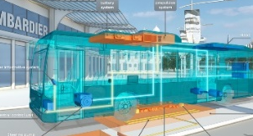
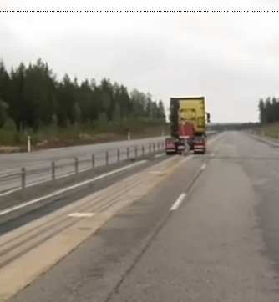
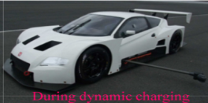
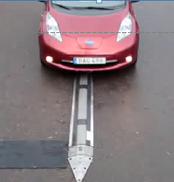
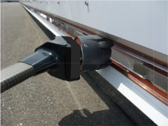
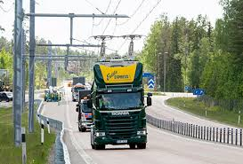

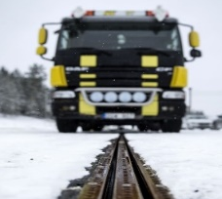

Many ERS concepts are developed
Different perspectives and needs of technology
In road
On road
Beside road
Above road
Inductive
Conductive

Slide 6
Continued work in the ERS-program (2018-22)
Experiences of different technologies
Demonstration-facilities
Pilot-facility
National investment plan for full scale deployment of ERS-systems
Evaluation, learning
Business model, legal aspects, conceptualisation, planning

Slide 7
Goals with pilot-facility/-ies
Full scale testing of all aspects of ERS-stretch
Only TRL-8 technologies
Testing, but considered as a permament facility
Evaluation important (following 1, 3, 5 yrs)
300 MSEK Sw Transport Adm/ 300 MSEK private actors
Etc.

Slide 8
Business model components in an ERS-system
Electricity system infrastructure
Elecric road
Related services
Power generation
Access control
Payment
National grid, 400kV
Road infrastructure
Information
Utilisation measurement
Vehicle
Access control
Transformation
Pick up
Areas of responsibility
Regional grid, 40-130kV
Power transfer to vehicle
(over head, inductive, conductive road surface)
Maintenace
Transformation
Electric grid along the road
Operations
Financing
Local grid, 10-20kV
Connection point to grid
Ownership

Slide 9
A model for interaction and financial flows
Power grid fee
Power grid owner
ERS fee
ERS operator
Payment for transport
Power provider
Transport buyer
Transport company
Power use fee
Vehicle manufacturer
Payment for vehicle and pick up/pantograph

Slide 10
Different actors for different ”building blocks”
Responsible actor
Concession or public
procurement
Public sector involvement
Business package 1:
Exisiting power grid
Under regulation of Swedish Energy Markets Inspectorate (EI)
Power grid operator
Power grid concession
Busienss package 2:
Electric road infrastructure
Swedish Transport Administration (initial phase)
In the short run; both forms
During full scale deployment: concession
Procurer in pilots and full scale phases
Business package 3:
Vehicles
NA
(except for subsidies)
Vehicle manufacturer
NA
Business package 4:
Systems for access control and measurement
ERS operator (?)
Preferably not
Preferably not

Slide 11
Four business-model building blocks
”Block” | Owner | Financing | Legislation | Supplier/customer
1. Access and measurement | Private sector Separate Combined with 3/4 | User fees |  | ERS operator/separate provider – single user
2. Vehicles | Transport services operator | Owners/customers | General market regulation | Manufacturer - customer
3. ERS infrastructure | a) Transport Administation (STA) b) Electricity company | User fees (public) User fees 4. a/b | Sw Road Law, EU legislation on fees etc | STA/El. grid/ERS operator – single user
4. Electric grid and power supply | Electricity market players Regulated Unregulated | User fees, access fees | ”Electricty Act”, EU legislation | El. grid company – single user/ERS operator

Slide 12
How to handle risk in pilot?
Risk-category | What? | Who covers? | How to mitigate?
Market | Less use than expected |  | Support to vehicle owners Guarantee? Sell-option?
Technology | Unsufficient function Short life time of technology |  | Only TRL 8/9 allowed
Planning | Delays and redesign | Sw Transport Adm? | Early planning process, cooperation and dialogue

Slide 13
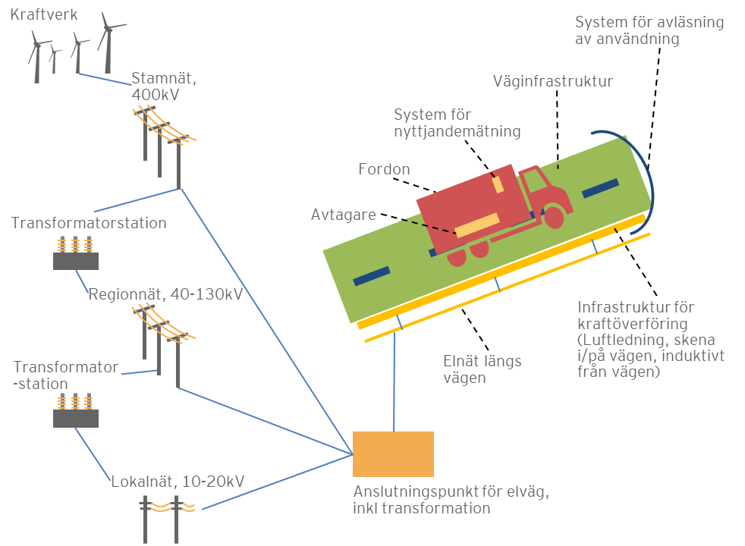
Business packages and possible actors
Vehicle manufacturers
Scania, Volvo
Obs! Exempel på aktörer
Transport Administration
Road infrastructure
Users/shippers
DHL, Schenker
Transport Administration, new operator
Siemens etc.
Electric road
infrastructure
Electricity trading companies
Fortum, Vattenfall etc.
Inside the formal road area
Grid owners
E.ON, Ellevio, Vattenfall etc.

Slide 14
Necessary actions ahead – pilot phase
Pilot-stretch constructed
Choice of pilot stretch and procurement of TRA’s part of faciilty
Legal analysis (planning,electricity markets, fees/taxes, payment systems (EETS), procurement, agreements, competition, state aid etc. EU-legislation, TRA regulation/role, exemptions)
Formal Road Plan and CB-analysis
Market actors to organise their part of ERS facility
Development of technolgies and concepts
Specifications/criteria for choice of pilot-stretch (functions, technology, safety, economics/financial model,maintenace, evaluation etc.)
Coordinated action by transport buyers, operators, vehicle manufacturers, technology providers and electricity market actors etc.
Business models
Business models
Agreement to define responsibilities and delimitations of ownership, financing, maintenace etc.
Procurement, negotiated procedure/ competitive dialogue etc.
2021- 2019 2018-2020

Slide 15
From now and until 2021 – two parallel processes
Pilot
Decision and construction
Where?
2019
Open application Dec – Feb
Physical planning
Legal analysis
Maintenance etc.
How?
2018-20
Business modelling

Slide 16
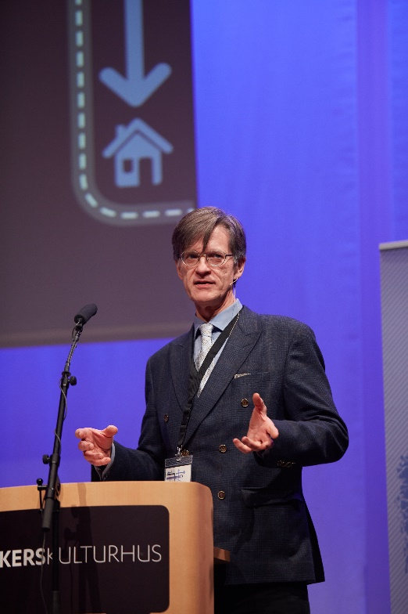
Björn Hasselgren, PhD bjorn.hasselgren@trafikverket.se
+46707623316

