Slide 1
WRA (UK) Congress 2018
Matthew Clarke MBA BEng Ceng MIET MCMI
Technical Director
Intelligent Mobility
SNC-Lavalin’s Atkins business
Thursday 15 November 2018
Supply chain and infrastructure – future mobility Future Mobility Technologies

Slide 2
CONTENTS Background The Future Uncertainties Scenarios Technologies 2025 Trends 2040 Trends Summary

Slide 3
“Technology is stuff that doesn’t work yet.” Bran Ferren (popularised by Douglas Adams)

Slide 4
The Future
Will look different from today;
Contains unknowns or uncertainties (innovations, rate of change, timings);
Includes elements not easily included in predictive models.
However, Looking ahead provides;
Clarification of timelines to decision points;
Avoidance of unnecessary early investment;
Direction and opportunities for planning;
The foundations for future customer satisfaction.

Slide 5
Scenarios
 | Transport Technology Deployment
Transport Consumption |  | Freely available and used | Limited availability or use
 | Universal | “Intelligent Isolation” | “Collaborative Users”
 | Tailored | “Individuals rule” | “Tailored Services”
Two meta-uncertainties framed as axes to create a 2x2 matrix;
“Deployment”
Lower than expected vs. higher than expected application of technology.
“Consumption”
Individualistic (tailored) vs collective (universal) extremes of transport usage.

Slide 6
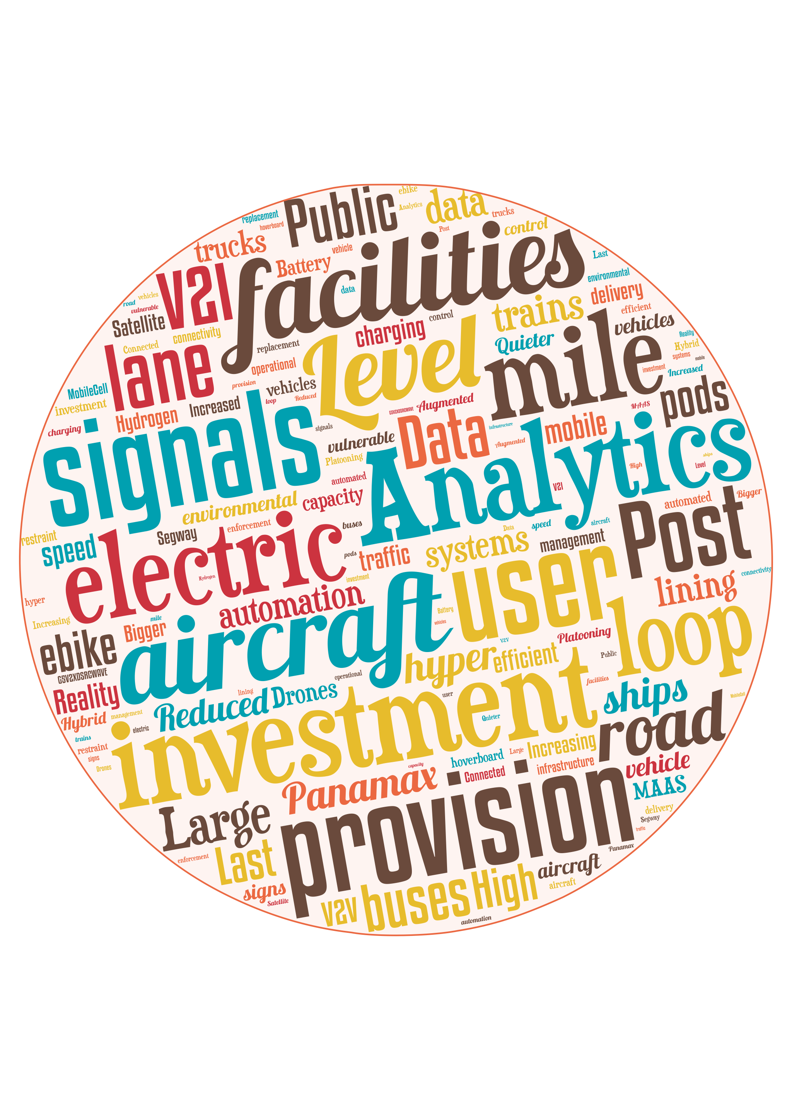
Technologies

Slide 7
2025 Vehicle trends
Truck platooning
Trials complete
Some deployment.
ULEVs
Commonly available (possibly the majority of new vehicles),
Most vehicles in the population will be ICVs.
MaaS pods
Trials and early deployments will be ongoing.
Connected Vehicles;
Viability demonstrated
Early deployments
Some corridors equipped
Last mile automation
Services will be developing
Limited initial deployments
Level 4 and 5 autonomy
Trials underway
Some early products available.
Notes:
Select Technology area (e.g. CAV, EV, V2X, Drones, Data Analytics);
Identify possible Intervention (e.g. prototype, regulation, standards, trials, infrastructure investment);
Establish criteria (e.g. desirability, practicability, value);
Rate technology against criteria;
Create comparative assessment of intervention;

Slide 8
2025 Infrastructure trends
Network Operations;
No significant reduction in costs for
enforcement technology,
operational management,
environmental monitoring,
signing,
lining,
vehicle restraint systems,
traffic signals
lane and speed control.
EV charging infrastructure
Developing (with gaps)
Dynamic EV charging
Trials performed
Early deployments.
Hydrogen distribution;
Limited
Battery exchange
Some deployments
Specific energy increasing.

Slide 9
2025 Comms trends
G5/V2X/DSRC/WAVE connectivity;
Increasing
Possibly covering urban areas and some of the interurban network.
Communications services
Public sector where private sector business case is weak
V2V and V2I technology
Trials will have demonstrated viability
Some early deployments.
Satellite services will be available.
Mobile apps and services
Widely available (e.g. to provide travel information ecall services).

Slide 10
2025 External trends
Drone delivery
Technology trials undertaken.
Early commercial trials underway.
Aircraft
Increasing capacity.
Reduced noise.
Increased efficiency.
Ships
increasing in size.
Big data
Solutions available for large urban areas and the trunk network.
Hyperloop
There will be no significant deployment
Early concepts under trial.
Augmented reality
Developing
Aligned with CAVs.

Slide 11
2040 Vehicle trends
PHEVs
Available for specialist vehicles only.
EVs
Ubiquitous, except for HGVs.
FCEVs
Common, but not universal.
MaaS pods
Ubiquitous.
Connected vehicles
Commonplace
Services and apps developing
Last mile automation services
Common and unseen.
Autonomous vehicles
Commonly available
A significant proportion of the vehicle fleet.

Slide 12
2040 Infrastructure trends
Network Operations;
Reduction in costs for
enforcement technology,
operational management,
environmental monitoring,
signing,
lining,
vehicle restraint systems,
traffic signals
lane and speed control.
EV charging infrastructure
Commonplace.
HGV dynamic EV charging
Some highways equipped for trials
Hydrogen distribution network
Available.
Battery exchange
Widespread (if specific energy).
Walking and cycling
Infrastructure managed to meet the needs.

Slide 13
2040 Comms trends
G5/V2X/DSRC/WAVE connectivity;
Universally available.
Communications services
Delivered by private sector.
V2V and V2I technology
Commonplace.
Satellite services will be ubiquitous.
Mobile apps and services
Everyday availability.

Slide 14
2040 External trends
Drone delivery
Commonly available
Heavily regulated
Aircraft
Efficient
Quiet
Some electric aircraft
Ships
”Panamax” ships common
Big data
Commonplace
Hyperloop
Early deployments underway (business case dependant)
Augmented reality
Part of CAV deployment.

Slide 15
Summary
ULEVs
Gaps in EV charging infrastructure
Energy production/distribution requires investment
Markets to develop
Technology trend impacts (specific energy)
New vehicle majority EV in 2025
EV dominates fleet by 2040
HGVs require alternative solution (e.g. dynamic charging)
Hydrogen production/distribution requires investment.
Integration of Energy and Transport
Connected Vehicles
Standards for provision to be developed
Services to meet customer and operational needs
Timing and rate of growth unclear.
Expected to be ubiquitous by 2040.

Slide 16
Summary
Autonomous Vehicles
Trials will progress through to at least 2025.
Early Level 4/5 deployments from 2025.
Becoming “normal” in 2025 for restricted environments (e.g. agriculture, ports, airports, warehousing).
Some early specialist applications (e.g. last mile delivery, truck platooning – depending on approvals).
Commonplace by 2040 (ubiquity dependant on public acceptance).
Data Analytics
Standards for data quality to be developed
Big data integrated into CAV provision from 2025.
Integration of Energy and Transport Networks (trials from 2025)
Don’t Panic!

Slide 17
Thank you
Visit our hub: www.atkinsglobal.com/im
Matthew Clarke
Technical Director
Intelligent Mobility
SNC-Lavalin’s Atkins business
Matthew.Clarke@atkinsglobal.com
© Copyright: Atkins 2018

