Slide 1
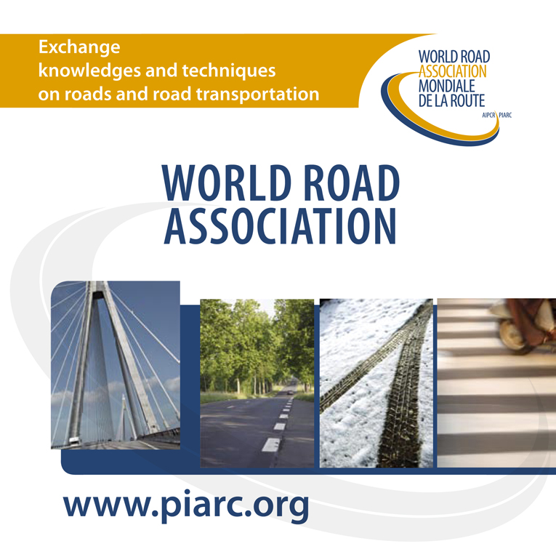

Electric Road Systems: a solution for the future?
Miguel Caso Florez – PIARC Technical Director
Dominic Leal – Researcher TRL

Slide 2

Electric Road Systems: a solution for the future?
Content of this presentation:
PIARC Special Project – ERS: a solution for the future? Miguel Caso Florez
ERS: technical aspects. Dominic Leal
ERS: development challenges and opportunities. Miguel Caso Florez

Slide 3
Electric Road Systems: a solution for the future?
PIARC Special Project – ERS: a solution for the future?
Miguel Caso Florez

Slide 4




Electric Road Systems: a solution for the future?
PIARC Special Project
PIARC Special Project mechanism aims to respond to emerging issues in the road sector within a limited time frame (12 months).
Special Project on ERS was proposed by Sweden and it was actively supported by Portugal and United Kingdom.
The following PIARC Technical Committees were involved:
TC D.1 Road asset management.
TC B.4 Freight transport.
TC E.2 Environment Considerations in Road Projects and Operations.
Selected external consultant: Transport Research Laboratory (TRL).

Slide 5
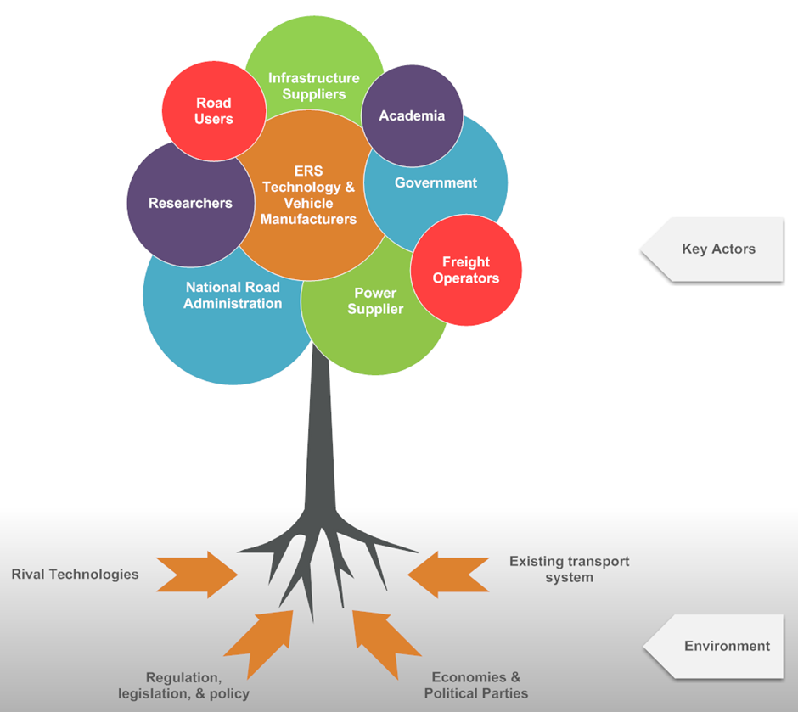
Electric Road Systems: a solution for the future?
PIARC Special Project
The report offers a global perspective on ERS both geographically and across road sector including perspective of NRAs, researchers, ERS developers, freight industry, vehicles manufacturers, energy providers…
The study had three interlinked phases:
State-of-the-art review and stakeholder engagement,
Technological and implementation feasibility assessment,
Exploration of the business model for ERS uptake.
Conclusions and recommendations.
The study includes the perspective of HIC and LMIC, and a review of stationary charging and other alternatives to fossil fuel propulsion technologies.

Slide 6
Electric Road Systems: a solution for the future?
PIARC Special Project
Section 1 provides an introduction and background to the project, outlines the project objectives, and sets out the scope of the report.
Section 2 describes the methodology and approach employed and the activities undertaken by the project team.
Section 3 presents the findings from Task 1. This includes a description of the various types of ERS concepts, and the results from the literature search, stakeholder survey and interviews, and the LMIC workshop.
Section 4 presents the findings from Task 2 which is an evaluation of ERS technologies and their perceived advantages and disadvantages.
Section 5 presents the business model from a road owner’s perspective. This includes the results from a UK-focussed cost-benefit analysis and discussion on how it could vary for different countries and scenarios.
Section 6 presents the project conclusions based on the work undertaken on Tasks 1, 2 and 3.
Section 7 presents recommendations for PIARC, road administrations and LMIC based on the conclusions found from this study.
Appendix A provides a copy of the survey questions and interview topics.
Appendix B contains details of the case studies reviewed in this project.
Appendix C compares the advantages and disadvantages of the different ERS technologies.
Appendix D provides a risk assessment of each ERS concept.
Appendix E summarises the findings from the LMIC workshop.
Appendix F describes the cost-benefit analysis model used in Task 3.
Appendix G presents summary sheets for each ERS concepts.
Appendix H is a bibliography for further study of ERS.

Slide 7
Electric Road Systems: a solution for the future?
PIARC Special Project
Section 1
Section 2
Section 3
Section 4
Section 5
Section 6
Section 7
Appendix A
Appendix B
Appendix C
Appendix D
Appendix E
Appendix F
Appendix G
Appendix H
ERS concepts
Environmental and social impacts
Cost-benefit analysis
Stakeholders perspective
Risk assessment
Types of business models
Technical feasibility and challenges
Future ERS
Case studies
Rival and complementary technologies
Impact on infrastructure and maintenance
Implementation in LMIC
Comparison of different ERS technologies
Regulatory framework and standards
Conclusions
Recommendations
Safety and security

Slide 8
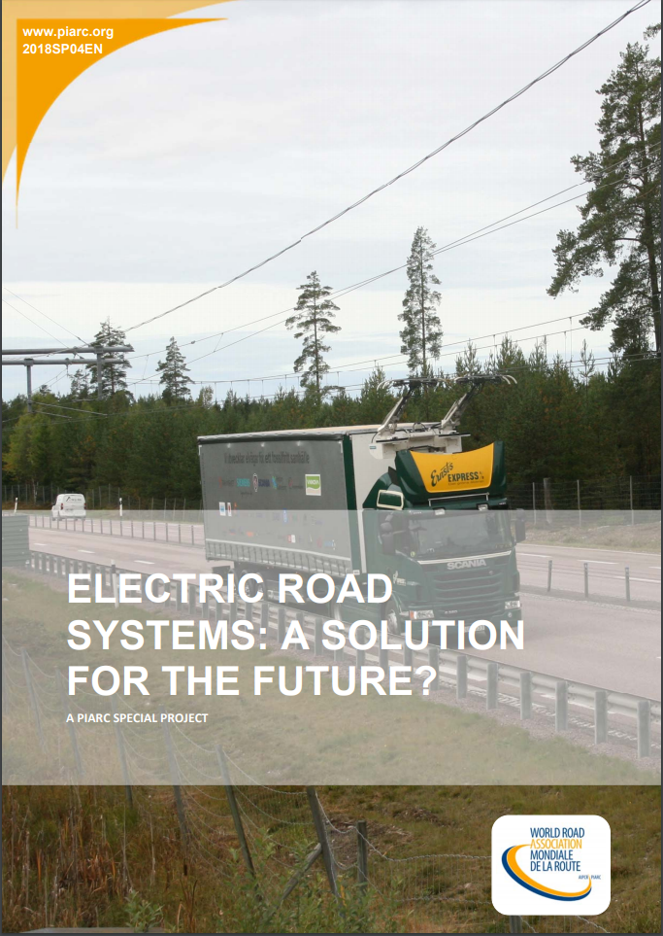

Electric Road Systems: a solution for the future?
PIARC Special Project
The report is available for free at www.piarc.org in English version (free registration).
French and Spanish versions will be available in the following weeks.

Slide 9
Electric Road Systems: a solution for the future?
ERS: technical aspects
Dominic Leal

Slide 10
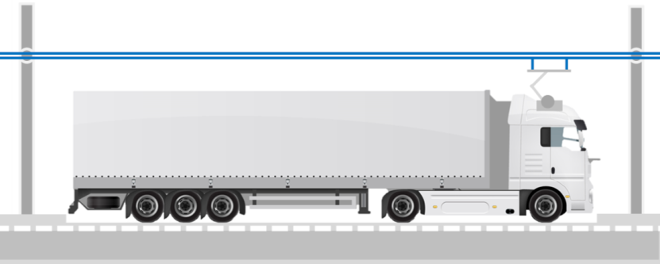
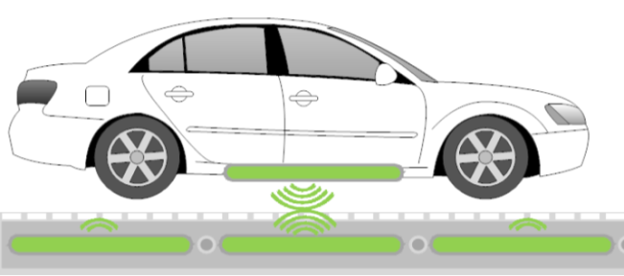
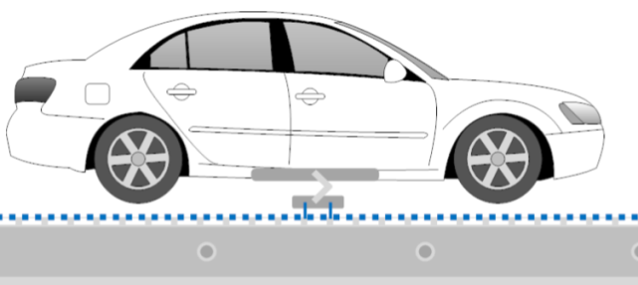


















Electric Road Systems: a solution for the future?
Types of ERS
Definition: A system capable of charging electric vehicles dynamically on-route at traffic speeds
Types: Three of technology (similar functions, very different designs & markets)
Inductive (Wireless)
Conductive Rail
Conductive Overhead
+ many other collaborators

Slide 11
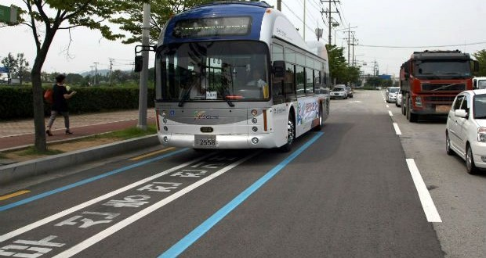
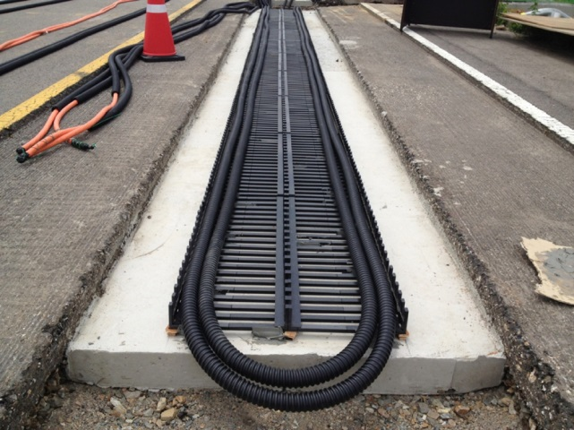
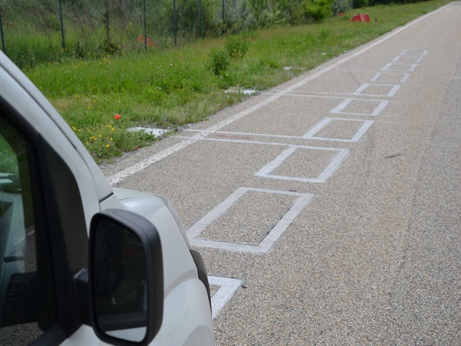
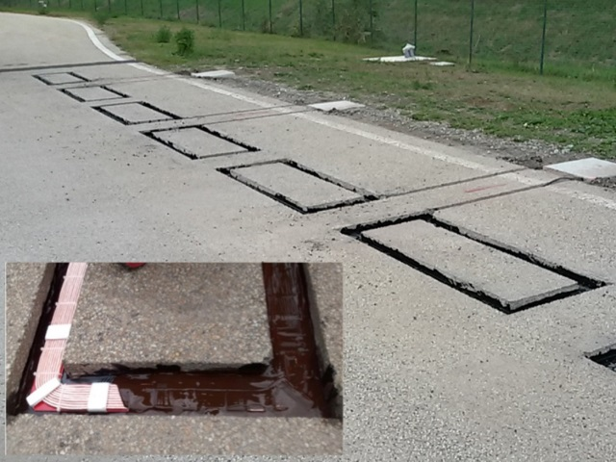
Electric Road Systems: a solution for the future?
Inductive (Wireless) Overview
KAIST / Dongwon OLEV public road demonstration, South Korea
Trenched copper/litz coils with a ferrite core and concrete foundations with asphalt overlay
FABRIC closed track demonstration, Italy
Trenched copper litz coils sealed in hot pour bitumen adhesive
Roadside Requirements:
grid connection transformer, inverter, cabling
power electronics, switching boxes between coils
high capacity battery & compensation
V2I and I2G communications system
monitoring unit, cooling unit
safety/security infrastructure
Many different designs, dimensions, power requirements, construction depths and techniques, essentially no interoperability between concepts

Slide 12
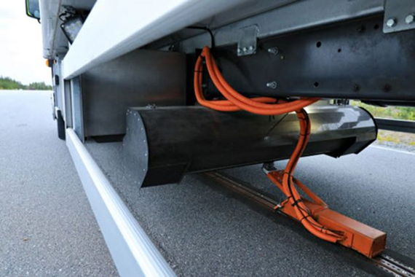
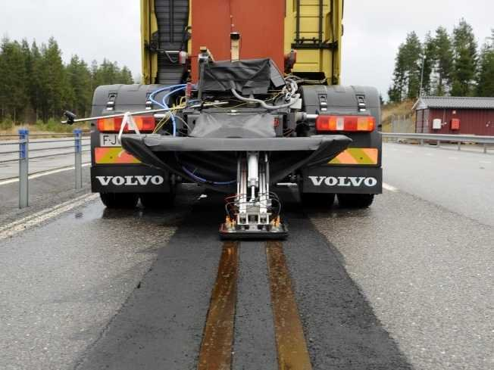
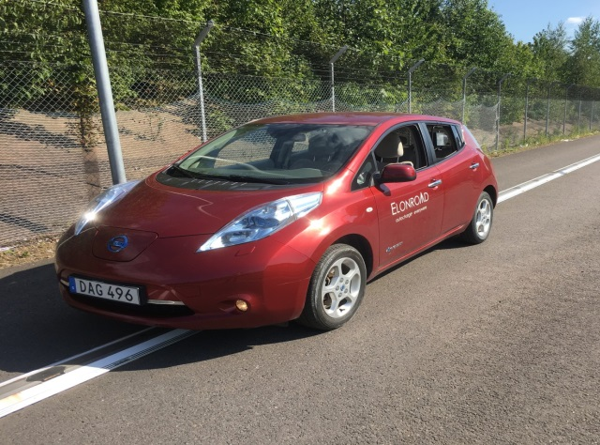
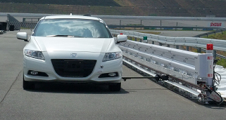
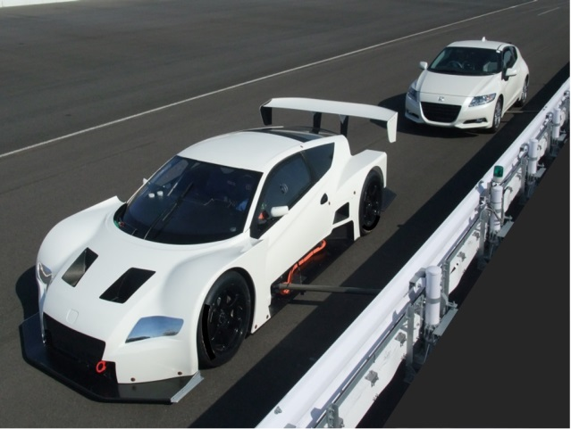

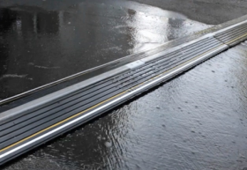
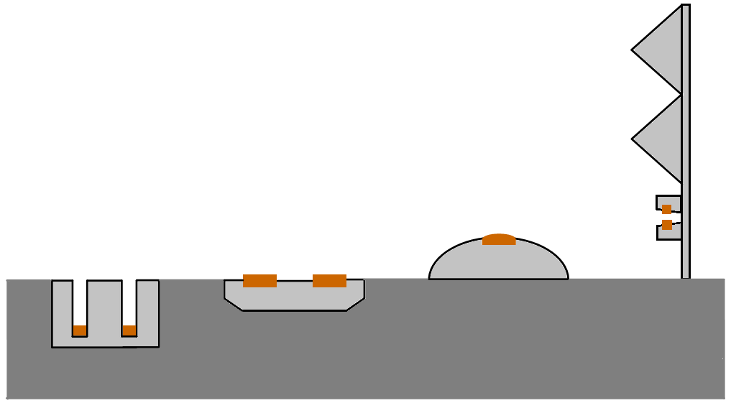
Electric Road Systems: a solution for the future?
Conductive Rail Overview
Channelled rail embedded in pavement, flush with surface
Flat rail embedded in pavement
Encased rail bolted on top of surface
Rail mounted to verge side vehicle restraint system
Roadside Requirements:
available grid connection
transformer, rectifier, power electronics
switching units, low/high voltage cabling
I2G/V2I communications systems (DSRC/wifi tags, etc.)
High-capacity storage batteries, air conditioning unit
remote sensing ICT
safety/security infrastructure

Slide 13
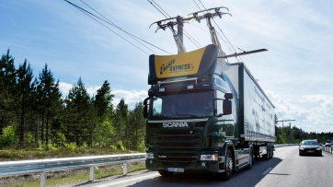
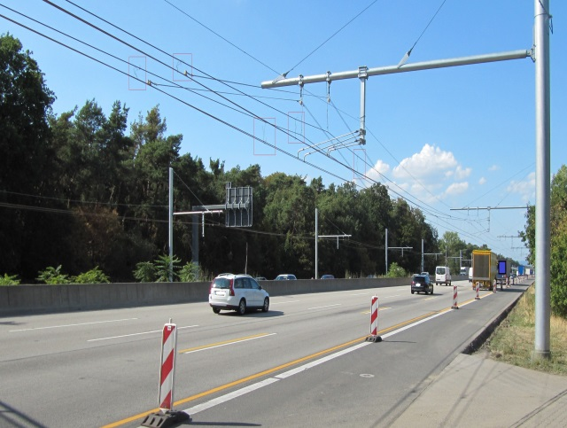
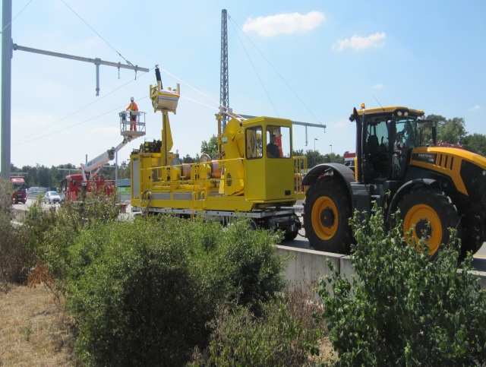
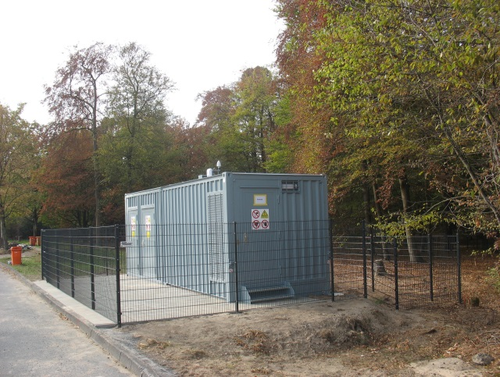
Electric Road Systems: a solution for the future?
Conductive Overhead Overview
Sweden, Germany, USA demonstrations underway
Verge side (option for median masts with arms spanning both directions)
Copper cables fed through hangers and tensioned
Rectifier substation and power electronics required every 1-4km
Roadside Requirements:
grid connection, transformer, medium voltage switchgear, rectifiers, controlled inverter
V2I and I2G communications system
monitoring unit, cooling unit
safety/security infrastructure
verge side vehicle restraint system
Many of the same infrastructural components used as in rail. Requires VRS along entire installation. Lengthy construction times

Slide 14
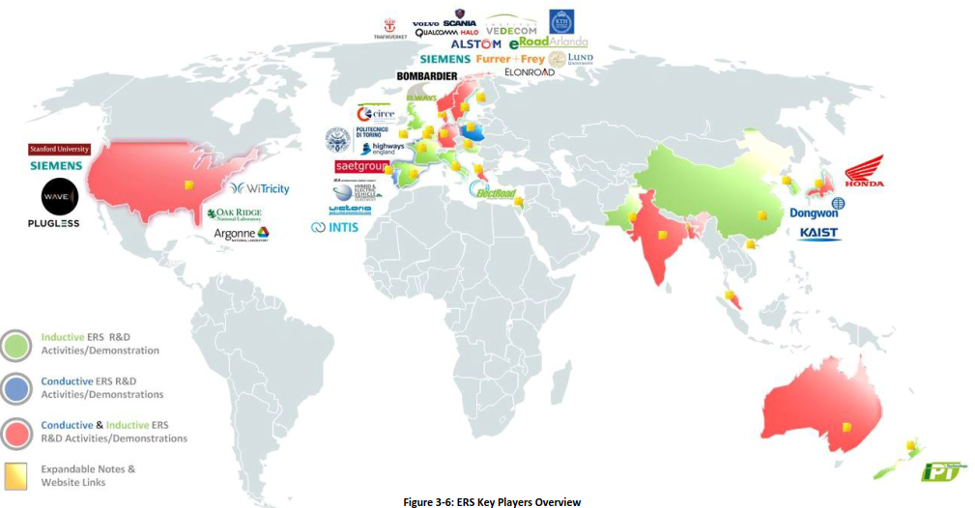
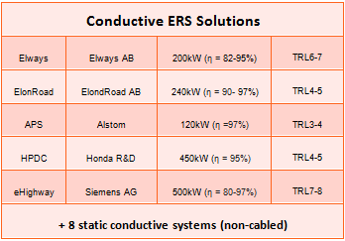
Electric Road Systems: a solution for the future?
State of Development
Interactive version: here

Slide 15
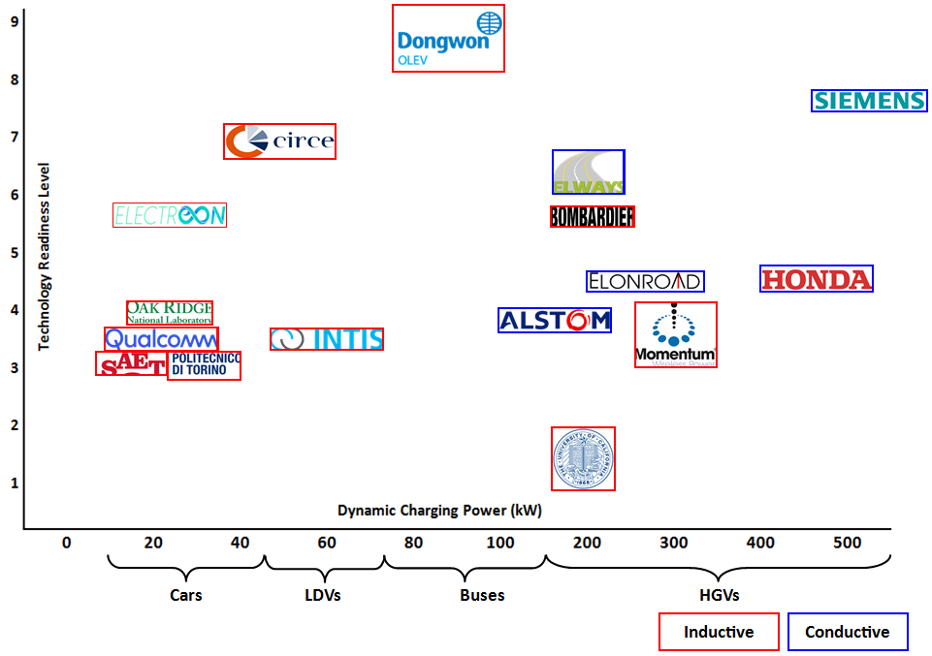
Electric Road Systems: a solution for the future?
State of Development
Flight Proven
Flight Qualified
Time to Deployment/TRL
(Stakeholder Estimates)
Inductive: 6 Yrs, TRL5
Rail: 6 Yrs, TRL5
Overhead: 5 Yrs, TRL6
Prototype Demo
Proof of Concept
Basic Principles

Slide 16
Electric Road Systems: a solution for the future?
ERS: development challenges and opportunities.
Miguel Caso Florez

Slide 17


Electric Road Systems: a solution for the future?
Opportunities
Understanding the ERS market:
Freight industry (HGVs) and public transport operators (buses) are likely first adopters of ERS.
Private passenger cars (LVs) are likely to charge at home if possible, as this is likely to be cheaper and more convenient than public charging facilities.
Private cars would only need ERS under very specific circumstances (over 90% of the rides are short and urban), while autonomous shared cars could need furthermore ERS.
Static charging facilities could be a significant competitor technology for LVs (less relevant to HGVs and buses) but they also play a complementary role on the EV uptake.
Adapting vehicles to ERS has a user cost => Only worth it if significant use: private cars?
KEY QUESTION: Who are we designing the ERS for? A system designed solely for HGVs may look very different to a system aimed a more mixed user group both technically and in terms of the business model.

Slide 18





Electric Road Systems: a solution for the future?
Challenges 1/2
Key barriers: high capital cost (for installation, maintenance and administration) and risks associated with relatively immature technology.
A key message from stakeholders was that government support is critical to ERS development and in addressing industry concerns.
Responsibility for ownership and operation of ERS technology remains to be defined. Most likely private public partnership would be needed for implementation. Modifications to the existing regulatory framework and concessions will be needed.
?

Slide 19



Electric Road Systems: a solution for the future?
Challenges 2/2
How many kms of ERS do we need?
Freight operators only require 25km per day of charging at ERS to achieve satisfactory payback compared to diesel.
20,000km of conductive rail ERS could provide €3.1bn annual savings compared to diesel use.
Interoperability:
Currently a variety of technologies have been developed and demonstrated with no interoperability between or within concept types.
The various conductive solutions proposed are all inherently non-interoperable.
The interoperability considerations for inductive power transfer systems are more advanced.

Slide 20


Electric Road Systems: a solution for the future?
Business model and government support 1/2
Funding mechanism: user-payer principle, but not only.
ERS can allow Governments to meet carbon reduction targets. Some governments may wish to partially subsidise ERS (at least initially to encourage take-up).
Users of ERS should have reduced costs compared to conventional fuels to support ERS development.
Electrifying only 5% of road network could produce a 50% GHG reduction of road transport.

Slide 21




Electric Road Systems: a solution for the future?
Business model and government support 2/2
Chicken and egg situation: hauliers only likely to purchase ERS equipment for their fleet if there are sufficient routes to use it and funders only willing to invest in installing the technology if there are sufficient vehicles with the equipment installed.
Government support is required for funding/part funding the initial investment and through policies and financial incentives to promote up-take.
KEY MESSAGE: Policy and regulatory framework clarity and stability overtime is essential.

Slide 22

Electric Road Systems: a solution for the future?
UK business model case study 1/2
?
Significant assumptions still needed in terms of take-up, electricity mark-up and operational costs etc. as these are currently unknown.
The outputs of the model are:
• The annual system operational costs, i.e. the maintenance and administration costs, plus the cost of the electricity used by the users.
• The annual benefits accrued from selling electricity to the users.
• Annual societal benefits (both in terms of absolute and monetary values); namely reduction in the CO₂ emissions, and reduction of the PM and NOx emissions at the tailpipe.
• Cumulative balance and payback time.

Slide 23
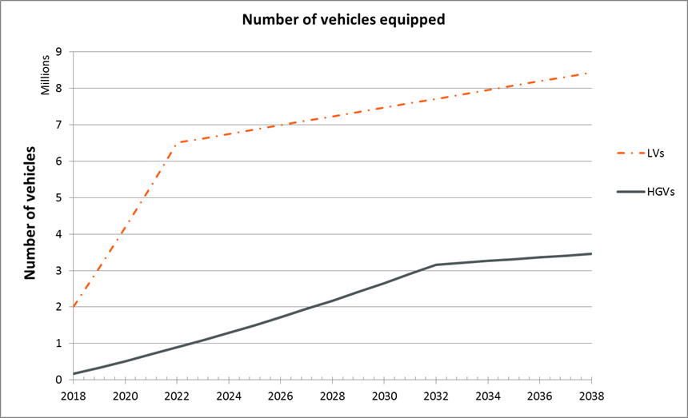
Electric Road Systems: a solution for the future?
UK business model case study 2/2
Technology penetration assumptions:
• Annual take-up rate for both LVs and HGVs: 5%
• Initial percentage of equipped LVs and HGVs: 5%
• Limit to the technology penetration in the LVs fleet: 30%
• Limit to the technology penetration in the HGVs fleet: 75%
 | Electricity mark-up 10% (similar to domestic price) |  | Electricity mark-up 65%
System | Break-even year | Savings after 20 years | Break-even year | Savings after 20 years
Inductive _{min} | >20 years | -0.4M£ | 6 | 5.7 M£
Iinductive_{max} | >20 years | -9.0 M£ | >20 years | -2.9 M£
Overhead_{min} | >20 years | -4.0 M£ | >20 years | -0.2 M£
Overhead_{max} | >20 years | -4.7 M£ | >20 years | -1.0 M£
Rail_{min} | >20 years | -0.4 M£ | 6 | 4.7 M£
Rail_{max} | >20 years | -2.5 M£ | 13 | 2.7 M£

Slide 24


Electric Road Systems: a solution for the future?
Recommendations for National Road Authorities 1/3
First steps:
• Participation in international conferences.
• Join PIARC and other international technical committees .
• Prepare a feasibility study: Safety; Technical feasibility and market-readiness; Specifications for the installation of ERS equipment into vehicles; and Specifications for road installations.
• Promote the use of low carbon vehicles.

Slide 25



Electric Road Systems: a solution for the future?
Recommendations for National Road Authorities 2/3
Intermediate steps:
• Assess the potential impacts of ERS
• Identify suitable routes for ERS
• Develop guidelines for ERS systems
• Identify specifications and standards that will require modifications
• Commission research
• Discuss the possibility of installing ERS with government and policy levers to encourage
• Create a cross-industry forum
• International standards and guidelines
• Including ERS as part of their low carbon vision
• Gain public support

Slide 26


Electric Road Systems: a solution for the future?
Recommendations for National Road Authorities 3/3
Advanced steps:
• Participation in trials.
• Work with government - Work with national government to ensure the regulatory framework is flexible enough to adapt to new transport technologies and business models.
• Publish results of trials.

Slide 27
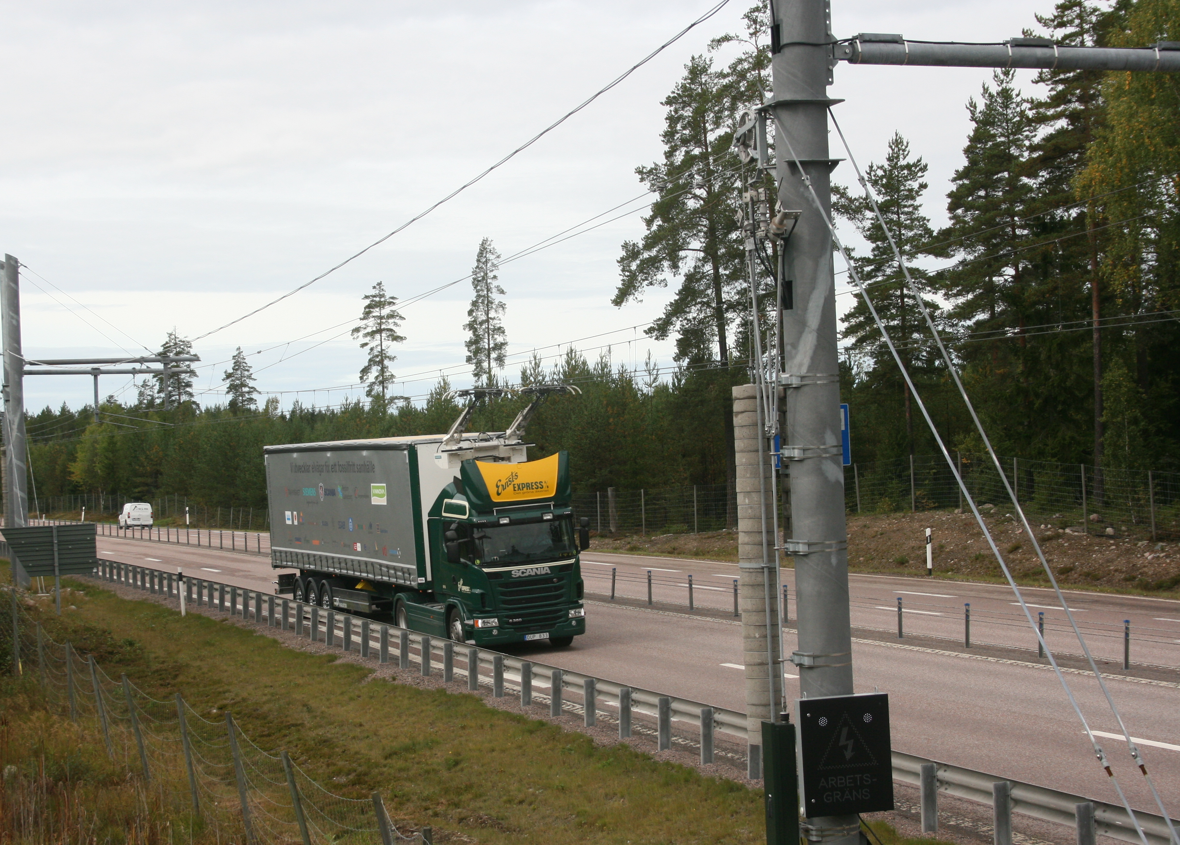
Electric Road Systems: a solution for the future?
Conclusions 1/2
The majority of the inductive ERS systems (50%) scored between TRL 3 and 4, only two systems had over 6.
The majority of the conductive ERS systems (60%) scored between TRL 4 and 5, the remaining two systems had a TRL between 6 and 8.
The KAIST/Dongwon OLEV (from South Korea) and the SIEMENS (from Sweden) systems appear to be the most advanced inductive and conductive ERS technology respectively and those closest to market readiness.
Risk assessments should be conducted for individual technologies and designs.
Static charging solutions and electric battery technology are seen to be complimentary to ERS development and implementation. Advancements in these areas should see an increased uptake of EVs

Slide 28

Electric Road Systems: a solution for the future?
Conclusions 2/2
The CBA shows that some types of ERS are financially viable if sufficient capital investment can be made, as long as the electricity mark-up and uptake is sufficient.
There is a need to better understand the market for ERS, in particular if LVs will use the system and the role of alternative technologies and other future social and technological changes (autonomous electric shared vehicles).
ERS has the potential to play a major role in the decarbonisation of road transport, but in the short term is most likely to be adapted by specific parties to meet localised needs rather than a universal solution.

Slide 29

Electric Road Systems: a solution for the future?
Thank you for your attention
World Road Association
info@piarc.org
@PIARC_Roads
Miguel Caso Florez
PIARC Technical Director
miguel.caso-florez@piarc.org
@miguelcasof
Download the report for free
at www.piarc.org

