Slide 1
Electric Vehicle Charging in the Urban Environment
World Roads Association – UK Congress
15th November 2018
Tim Armitage

Slide 2
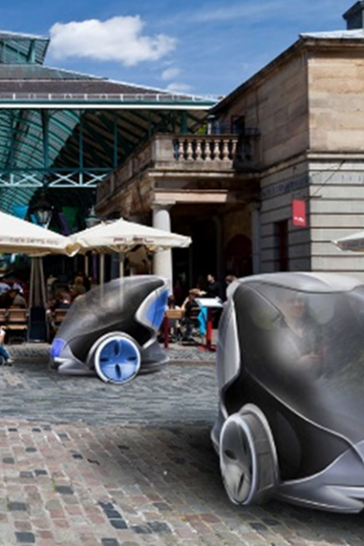
Future of urban mobility
Road transport is changing (quickly):
  Convergence of key technologies
  Changes in social attitudes

Slide 3
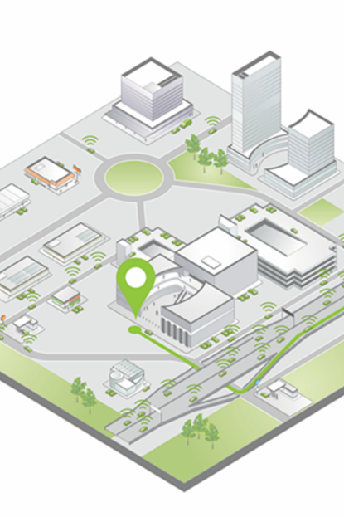
Global mega-trends
Decreasing private ownership
Desire for decreased emissions
Increasingly connected vehicles
Increasingly automated vehicles

Slide 4
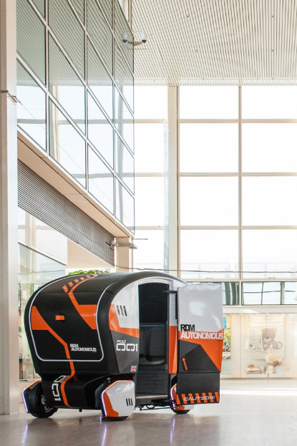
Decreasing private ownership
Less demand for private ownership
Shared ownership will come to dominate
Mobility as a service models being introduced
Traditional automotive OEMs transitioning to mobility providers

Slide 5

Decreasing emissions
Government legislation will ban sales of pure ICE cars from 2040, some pressures to do this much earlier
Health concerns focus on NOx, SOx and PM₁₀
Electric and electric hybrid currently only mainstream solution, hydrogen fuel cells may emerge as viable solution

Slide 6
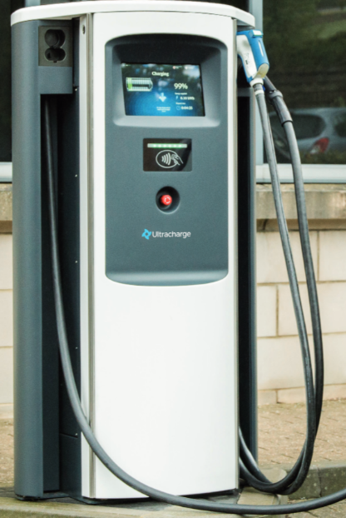
Decreasing emissions
Electric vehicle charging still developing
Normal (3kW) Fast (7kW) and Rapid (50kW) well established
CHAdeMO, CCS and Type 2 connectors
New formats up to 350kW rolling-out

Slide 7
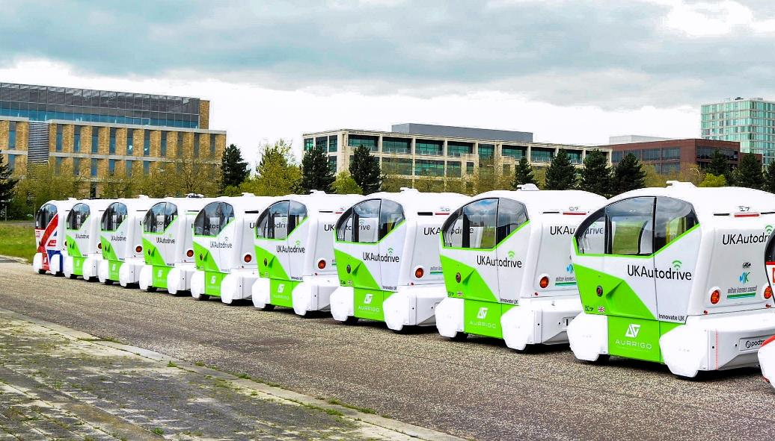
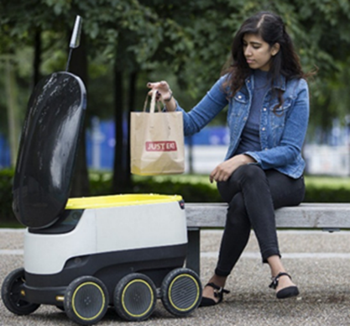
Increasingly autonomous vehicles
Not just passenger cars
Vans, buses and HGVs (platooning)
Third generation ‘pods’
Small parcel delivery vehicles

Slide 8
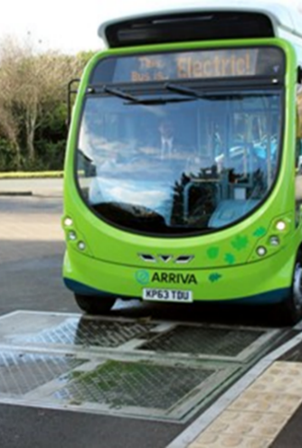
Electric vehicle market:
Electric vehicles (pure battery and hybrid) still a small fraction of parc
Supply of vehicles is limited
Common belief that there is insufficient charging infrastructure, but:
Existing infrastructure is under used

Slide 9
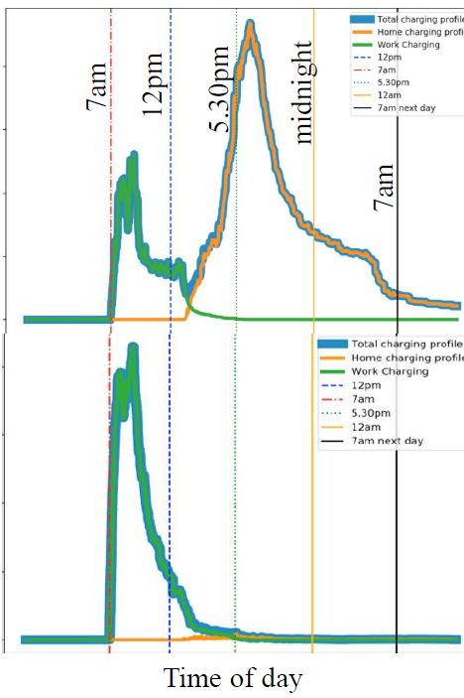
Future power demand:
If we make some assumptions about vehicle origin and destinations we can estimate power demand
Suburban charging and urban charging have different profiles

Slide 10
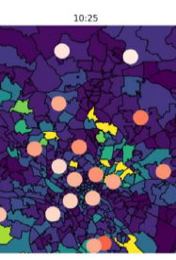
Future power demand:
Possible to map peak demand throughout urban environment

Slide 11
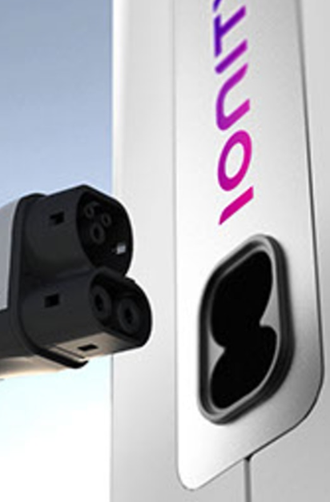
Into an uncertain future ………
Positioning of EV charging facilities to become more strategic than pragmatic
Intelligent chargers used to control grid loading
Kerb management becomes more important
Interoperability will remain an issue

Slide 12
Thanks for listening
Tim.Armitage@arup.com

