Slide 1

Scotland’s approach to electric vehicle charging
Laurence Kenney, MEng, MSc, CEng, MCIHT
ULEV Delivery
Low Carbon Economy Directorate
Transport Scotland
Scottish Government
Notes:
Intro
The ERS special project identified that a key enabler of moving towards such systems is the wider promotion and adoption of electric vehicles across the fleet.
The most successful technology for electric cars and vans is stationary conductive or plug in charging.
I’m going to take a few minutes to explain what Transport Scotland has been doing to build the ChargePlace Scotland charging network.

Slide 2
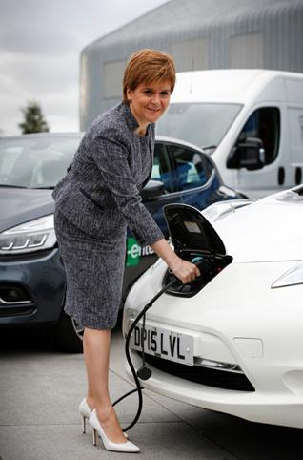
Mission: Phase out the need for new petrol and diesel cars and vans by 2032
Priority 4
Incentivise consumers to make informed choices on the purchase, access and use of ULEVs
Priority 3
Scottish businesses engage in and benefit from the shift to ULEVs
Priority 2
Embed new skills and capabilities into the Scottish workforce
Priority 1
Support a user focused, state-of-the-art network of charge points supporting Scotland’s energy needs
OUTCOMES
Scotland at the forefront of growth in ULEV markets.
A fair distribution of investment costs, benefiting all consumers.
Business benefitting from new markets and technologies
“We will step up our work in the year ahead…”
Notes:
Infrastructure is just one part of the overall strategy.
As Roy highlighted our overall mission was set out by the First Minister of Scotland:
Mission: Phase out the need for new petrol and diesel cars and vans by 2032
Priority 1: Support a user focussed, state-of-the-art network of charge points supporting Scotland’s energy needs
Priority 2: Embed new skills and capabilities into the Scottish workforce
Priority 3: Scottish businesses engage in and benefit from the shift to ULEVs
Priority 4: Incentivise consumers to make informed choices on the purchase, access and use of ULEVs.
Outcomes
Scotland at the forefront of growth in ULEV markets
A fair distribution of investment costs, benefiting all consumers.
Business benefitting from new markets and technologies.

Slide 3

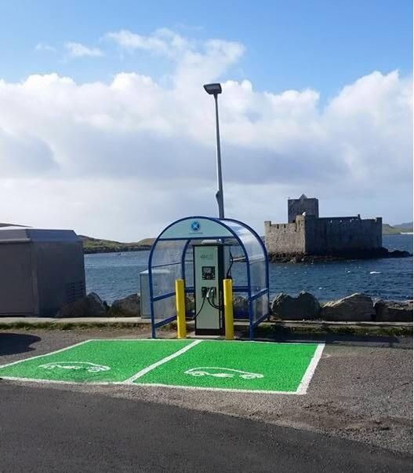
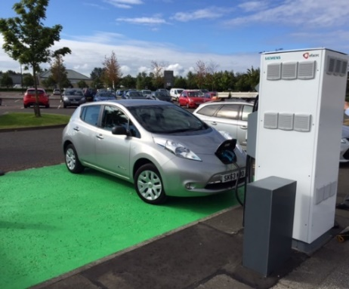

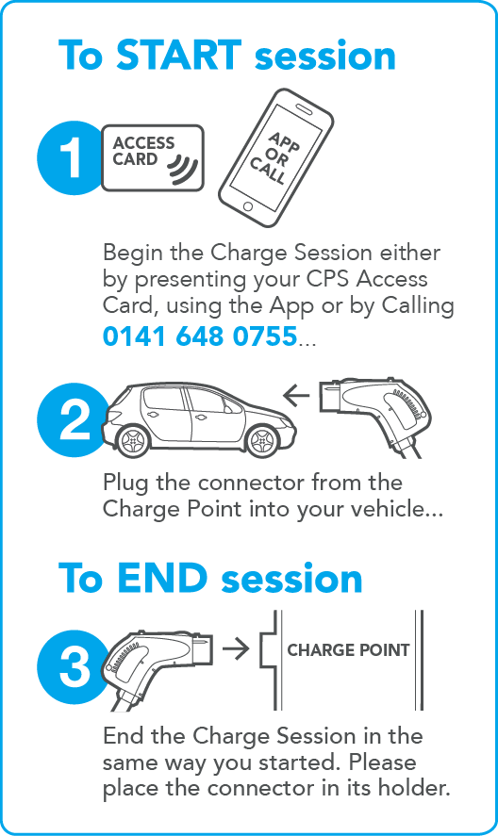
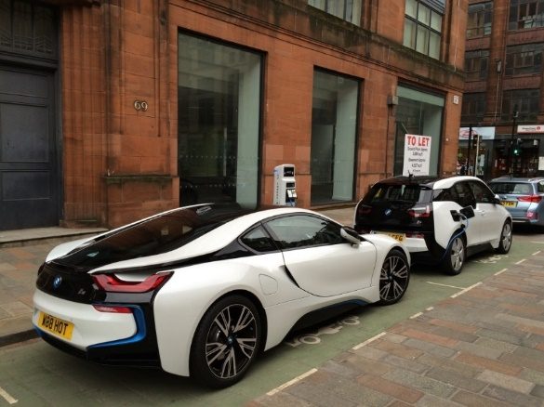
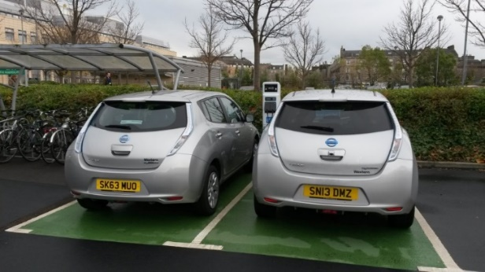
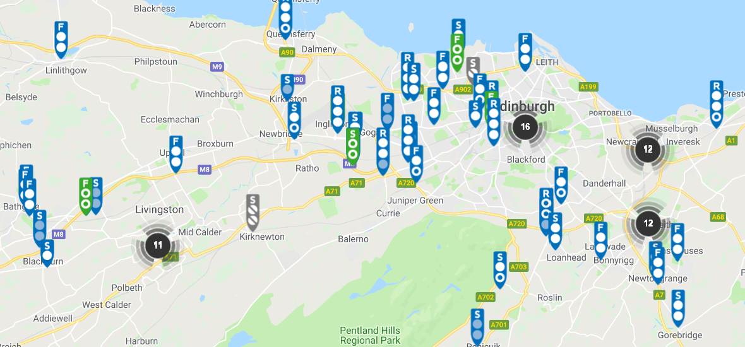
ChargePlace Scotland
Grant programmes:
        Local Authorities
        Commercial
        Domestic
      Back Office System
Notes:
Network started in 2011/12 when Transport Scotland was successful in securing ‘plugged in places’ funding from the UK Government.
The bid was a partnership between Transport Scotland and all 32 local authorities.
Since through early years the network has continued to grow funded internally by the Scottish Government.
Grant funding to local authorities.
Funding EST to commercial premises.
Top up grants for domestic charge points

Slide 4
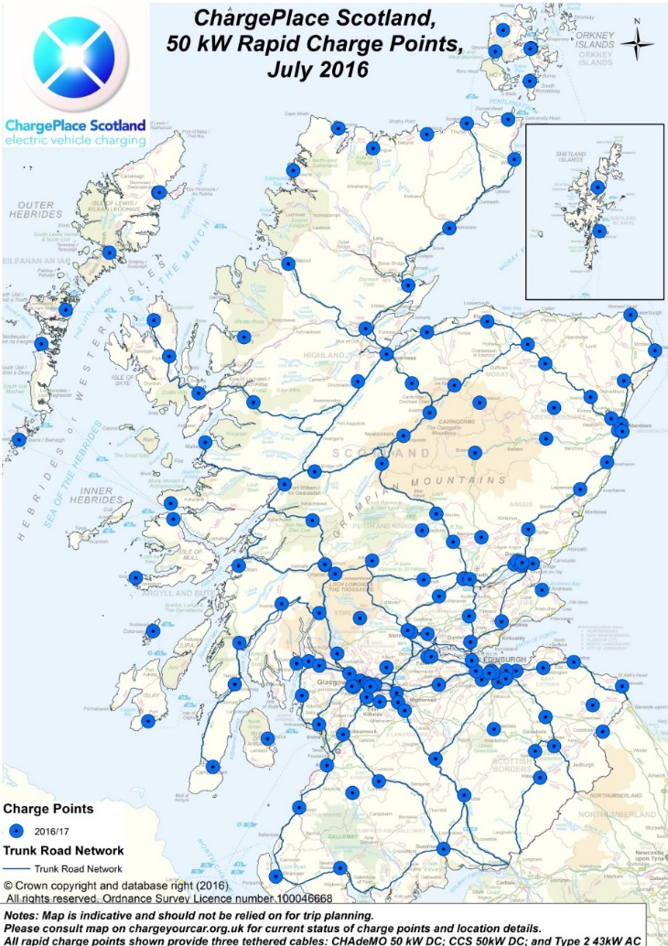
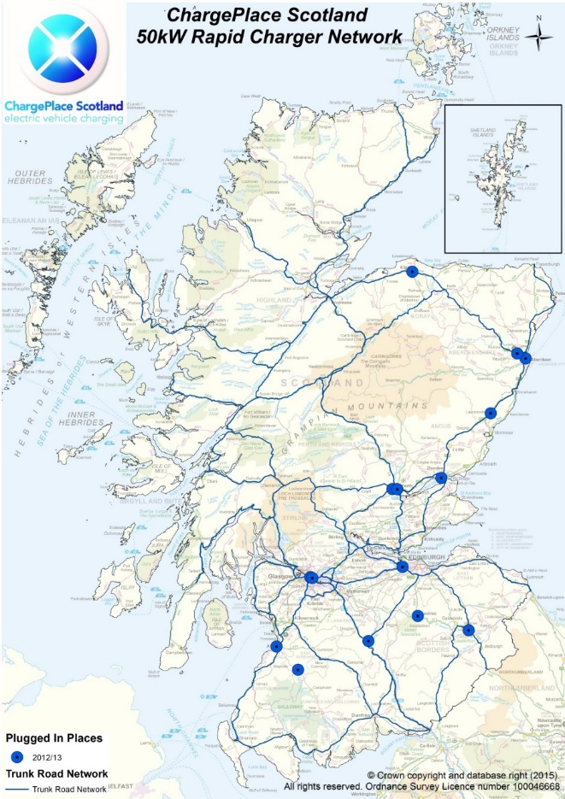
Network Growth
Total kWh drawn by year
Notes:
Network has grown across the country.
Significant growth in usage
Total of 13 million miles in 2017.

Slide 5

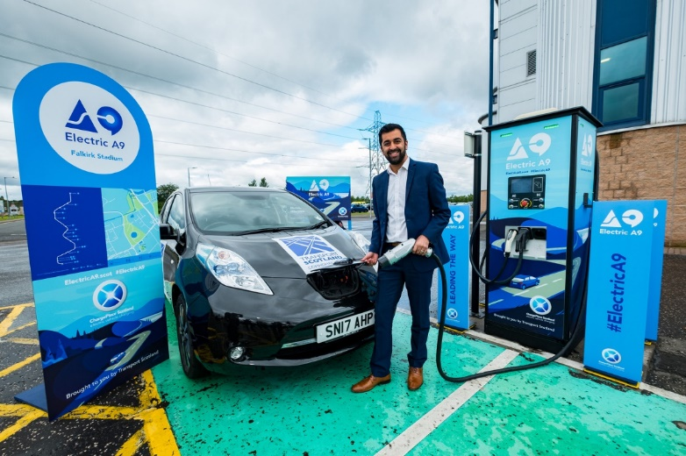

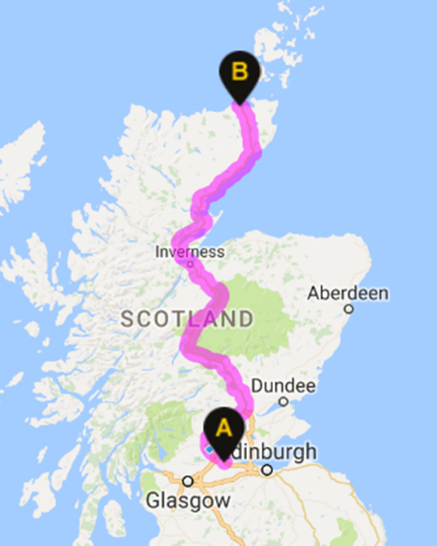

Multiple EV charge place hubs
Hubs located in or around local communities
Multiple charge points with access to associated amenities
Expand and reinforce Scotland’s existing EV infrastructure
Accommodate all users - journey, destination, local

Slide 6
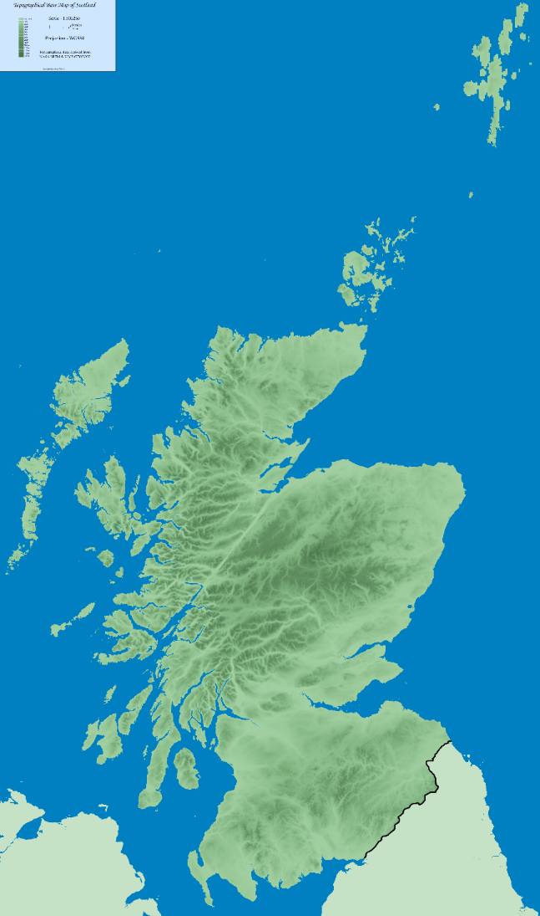
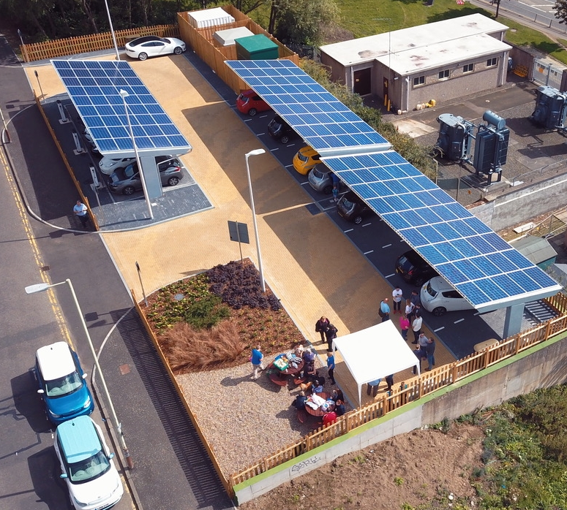
Charging Hubs
Sub Station
Switch Cabinet
Battery Storage
ERDF Low carbon transport hubs
Aberlour
Dundee x2
Falkirk
Forfar
Inverness
Perth
Stirling
Stromness
6 x rapid charge points
3 x 22kW charge points
Seating Area
Other hubs
Dundee GUL
Glasgow H2020
Solar Panels

Slide 7
Thank You

