Slide 1
CIHT Cycle Infrastructure
Peter Hewitt and Ben Coleman

Slide 2
Agenda
About us
What is Cycle Infrastructure?
A shift in emphasis
Project Examples
The Transport for London Experience
What could this mean for the IoM?

Slide 3
About us
Peter - Project Director and recently joined MM from Transport for London
Ben - Principal Transport Planner, worked at MM for three years with background in local authority and consultancy
We’re both based in the Transport Planning and Engineering Team within Mott MacDonald with 45+ colleagues. The team is a mixture of transport planners, engineers, urban designers and modellers.

Slide 4
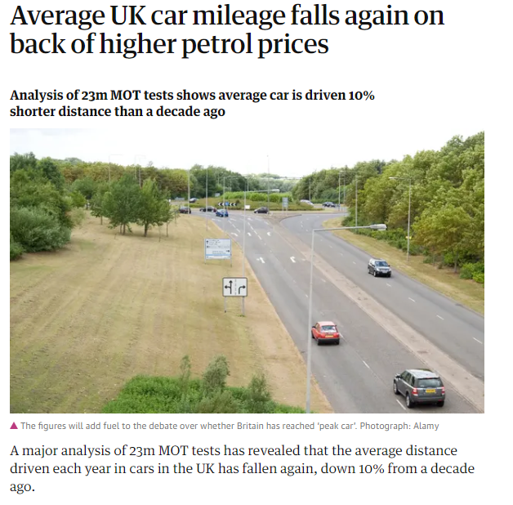
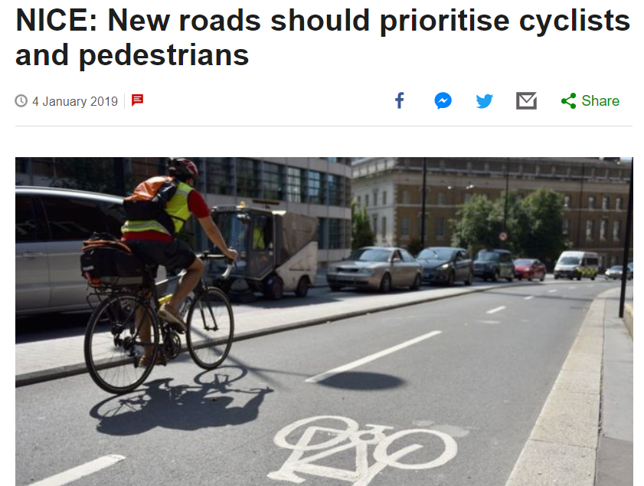
A shift in emphasis

Slide 5
A shift in emphasis

Slide 6
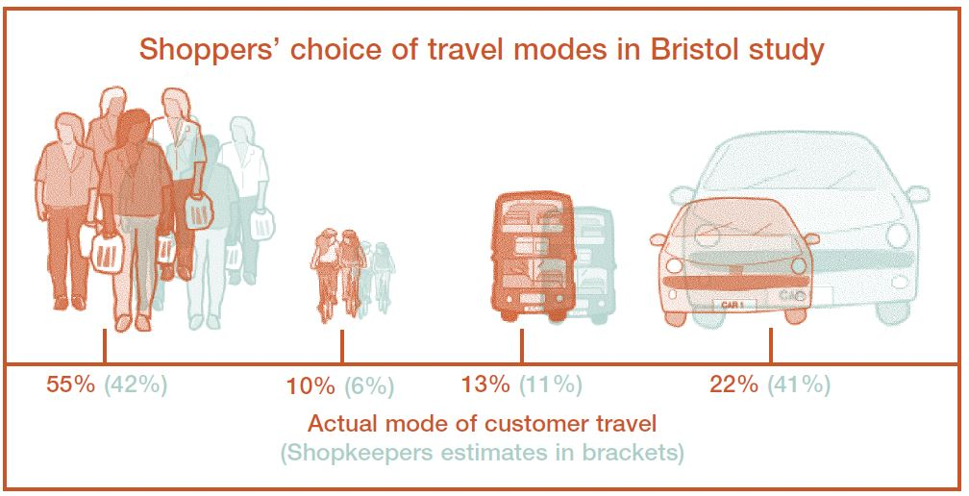
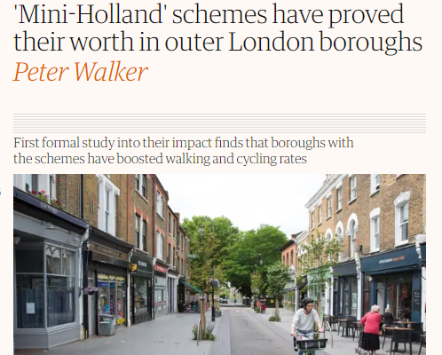
A shift in emphasis

Slide 7
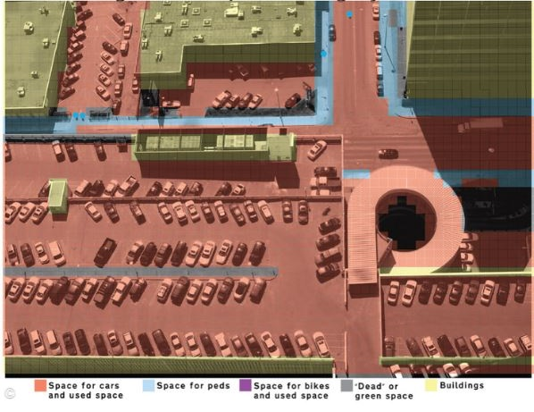
A shift in emphasis

Slide 8
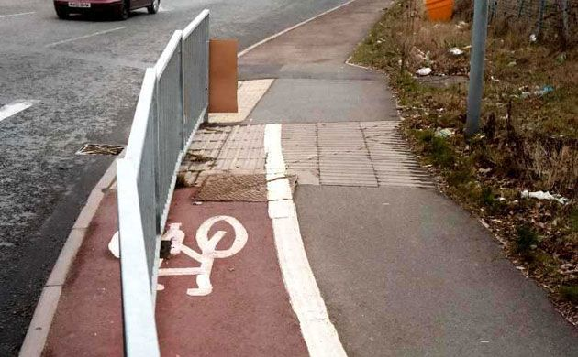
What is cycling infrastructure?

Slide 9
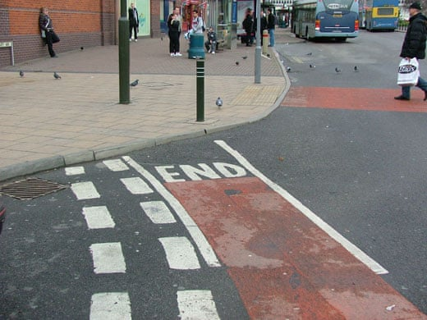
What is cycling infrastructure?

Slide 10
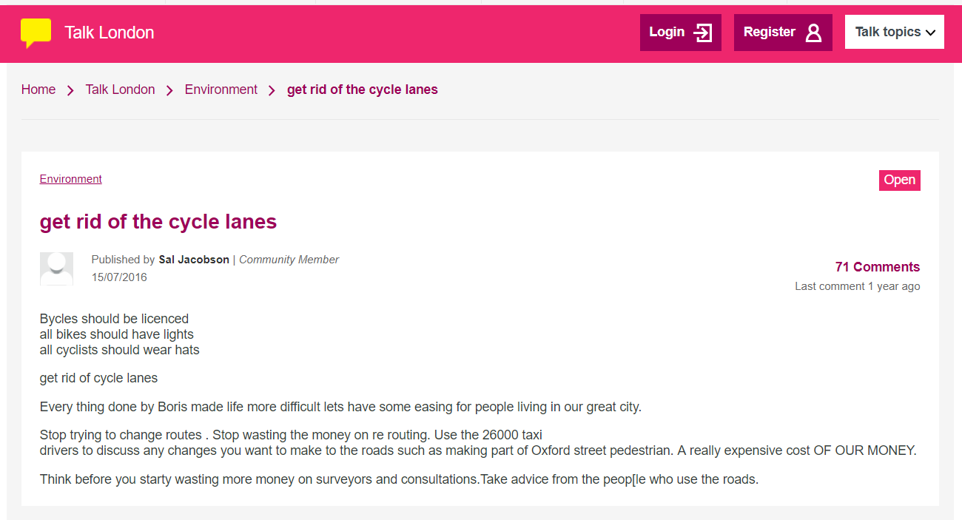
What is cycling infrastructure?

Slide 11
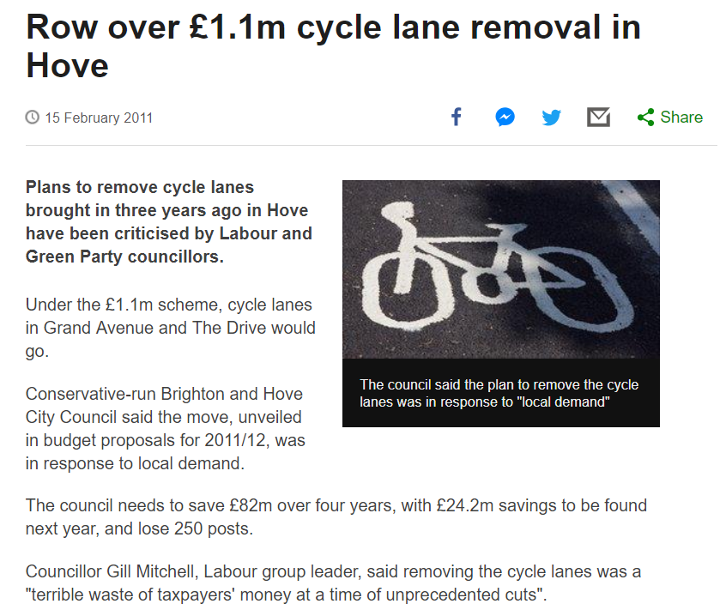
What is cycling infrastructure?

Slide 12
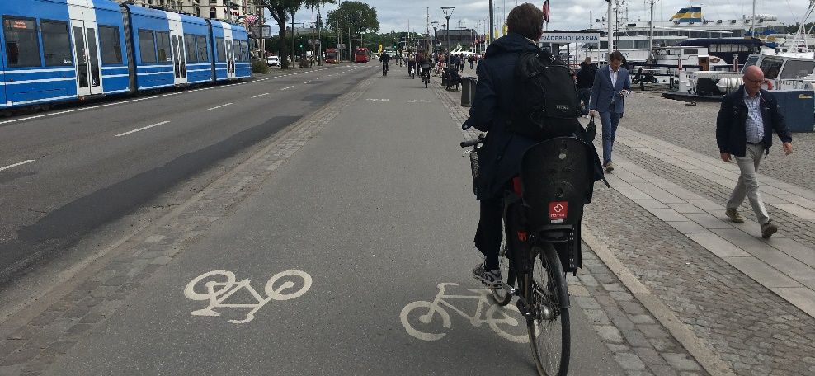
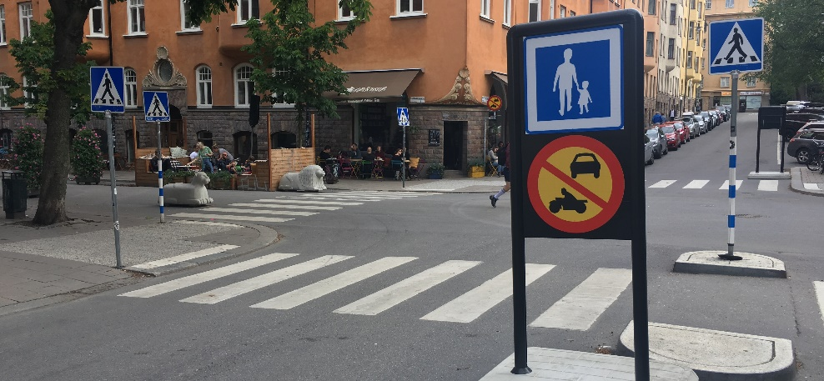
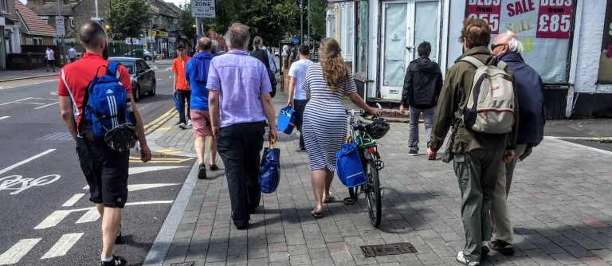
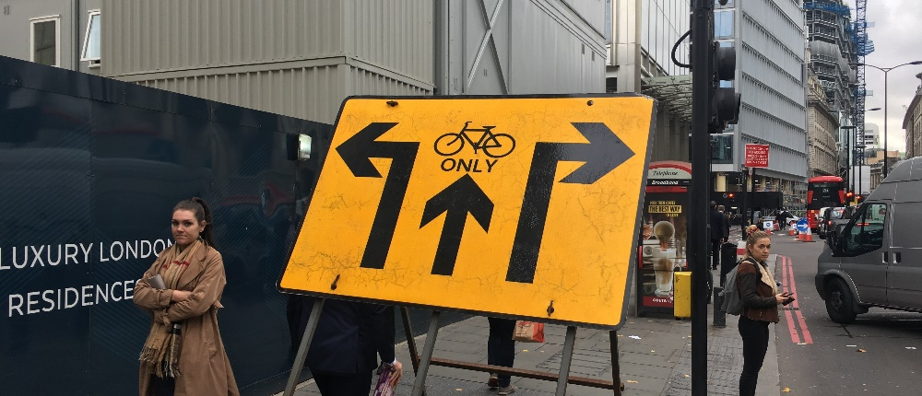
What is cycling infrastructure?

Slide 13
Cycling is not just for cyclists

Slide 14
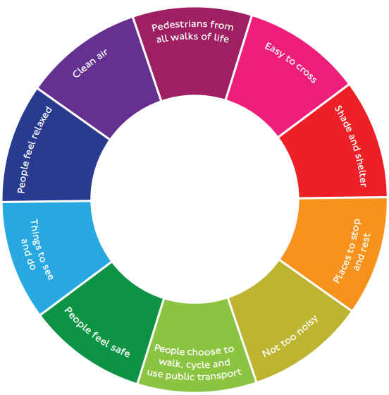
Cycling is not just for cyclists

Slide 15
What has this meant for our projects?
Increasing emphasis on scheme gains beyond cycling
More robust baseline evidence required to support schemes
More sophisticated tools for analysing cycle infrastructure
Design standards ever increasing
Increased public interest, demand and scrutiny

Slide 16
What has this meant for our projects?
Local Walking and Cycle Investment Plans (LCWIP)
CYcle NEtwork Model for LondON (Cynemon)
Central London Coach Station (CLCS)
Olympic Cycle Masterplan
Worthing Seafront Investment Plan
Seven Dials Roundabout, Brighton

Slide 17
Local Walking Cycle Investment Plans (LCWIP)
LCWIP = Local Cycling + Walking Investment Plan
New Department for Transport (DfT) approach to encourage Local Authorities to have long-term walking and cycling plans
Extensive data collection essential for creating basis of strategy and measures to achieve Complete Streets.
3 x Key LCWIP tools: Propensity to Cycle (PCT), Walking Route Assessment Tool (WRAT) and Route Selection Tool (RST)
MM working with 5 x Local Authorities in development of LCWIPs
https://www.pct.bike/m/?r=liverpool-city-region

Slide 18
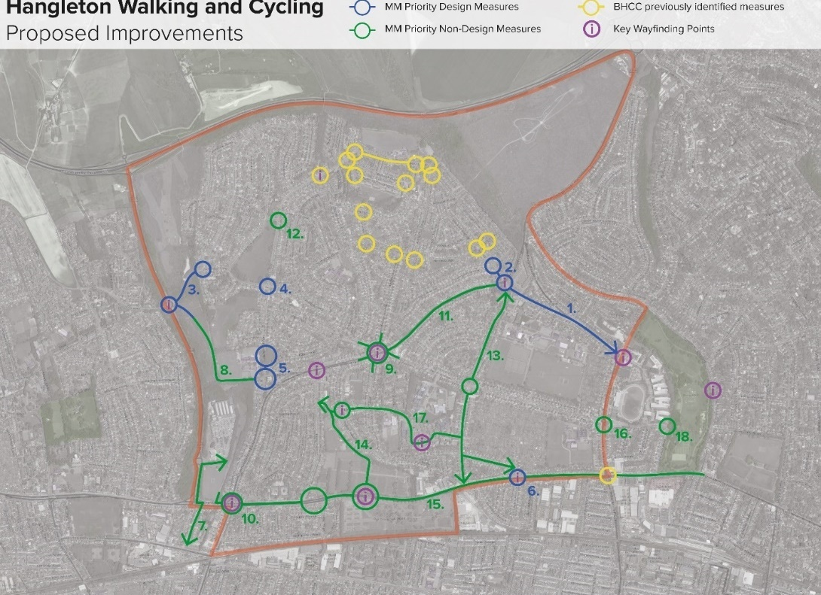
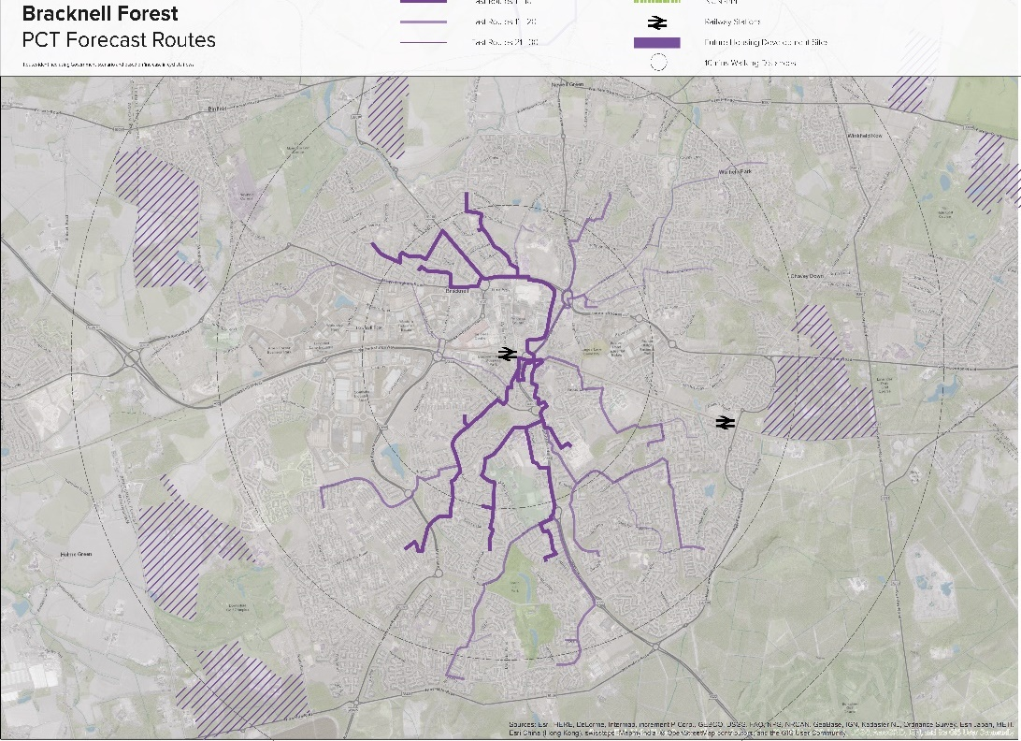
Local Walking Cycle Investment Plans (LCWIP)

Slide 19
Cynemon Cycle Model
‘Cycle Network Model for London’ (CYNEMON) is the new strategic cycle model developed by Transport for London which enables forecasting up until 2041
Cynemon developed to estimate cycle flows, journey times and routings
MM appointed by LB Croydon to review the impacts of proposed segregated cycle infrastructure upon cycle trips and distribution of cycles flows
Cynemon outputs were used in tandem with MM’s VISSIM modelling to create full picture of modelling and future flows

Slide 20
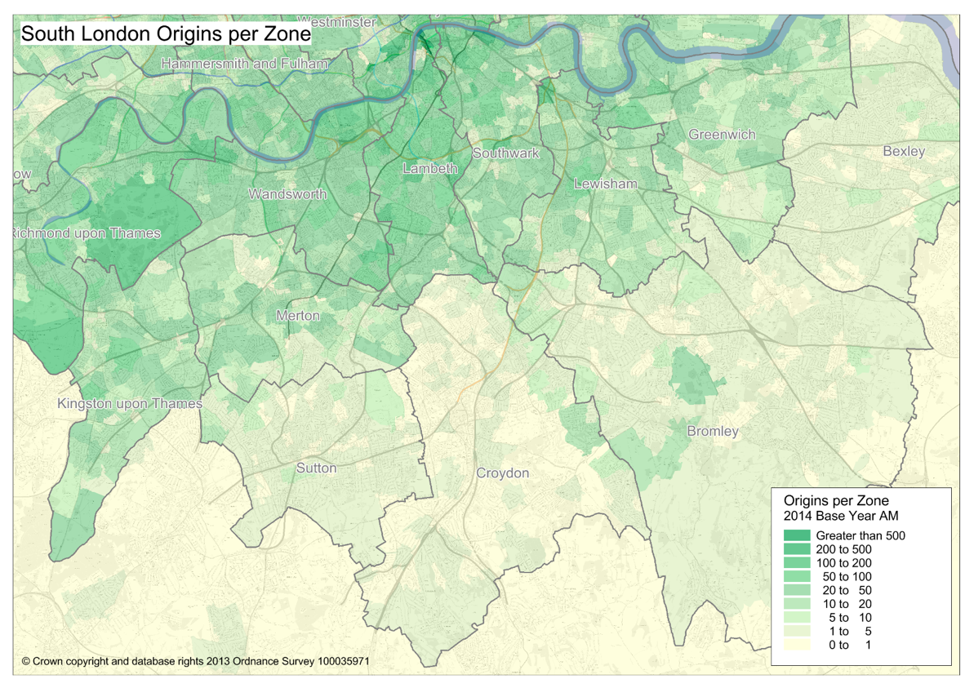
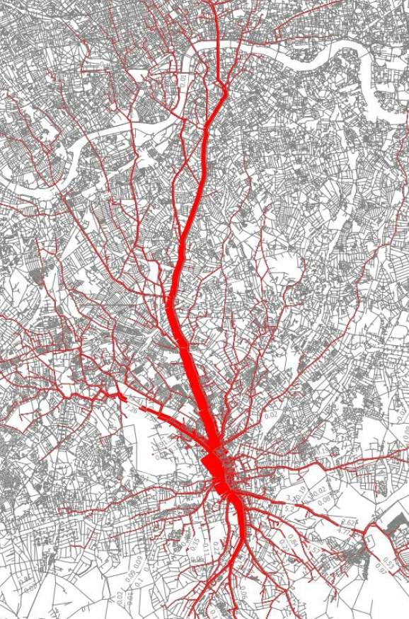
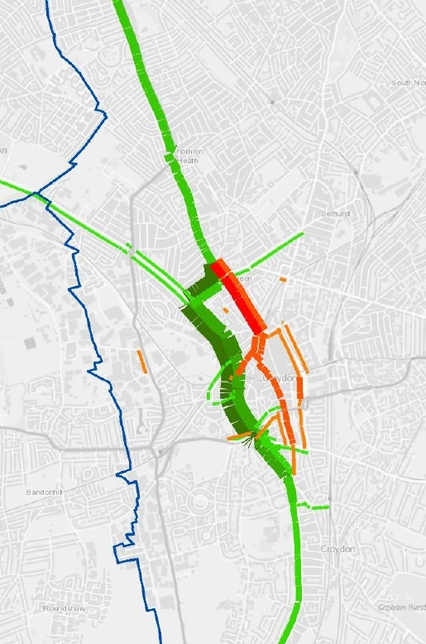
Cynemon Cycle Model

Slide 21
Central Coach Station, London
Development Site was identified through design competition as best location for relocated coach station but arguably worst choice location for walking and cycling
Mott MacDonald developed Urban Planning Strategy for relocation London’s central coach station
Complete Streets at core of Urban Planning Strategy for transforming streetscapes and long-term overhaul of area
Traffic Demand Management (TDM) was key aspect of strategy for promotion of Active Travel and encouraging users of the Coach Station to reconsider how they travel to the site

Slide 22
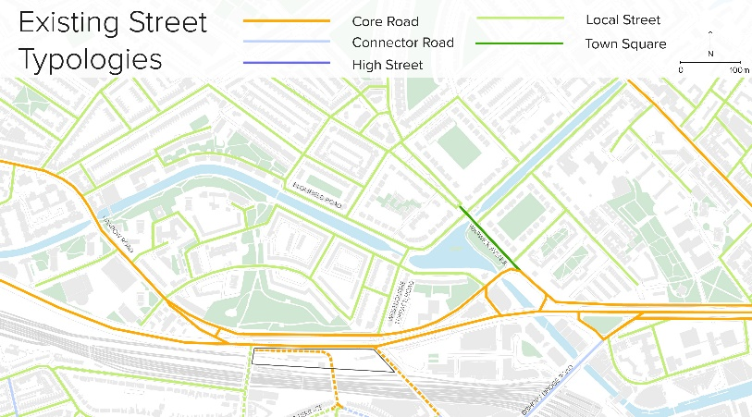
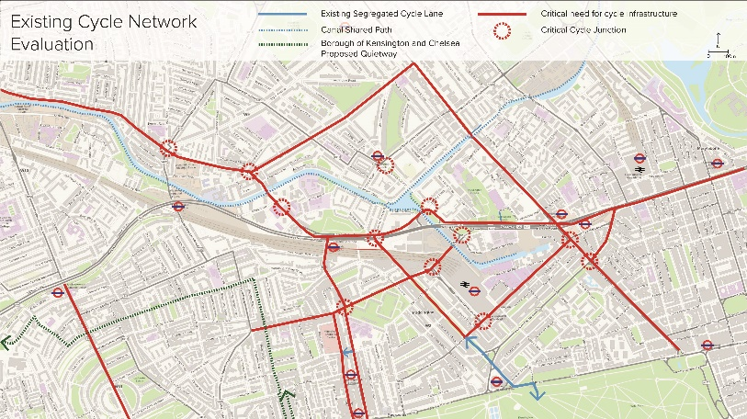
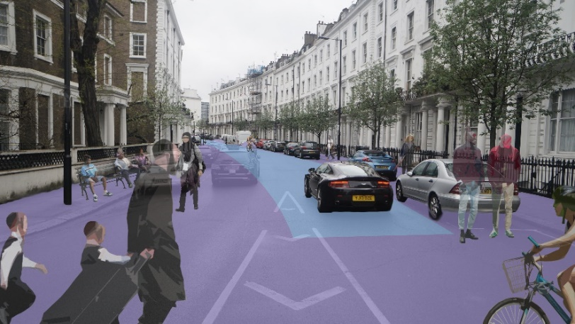
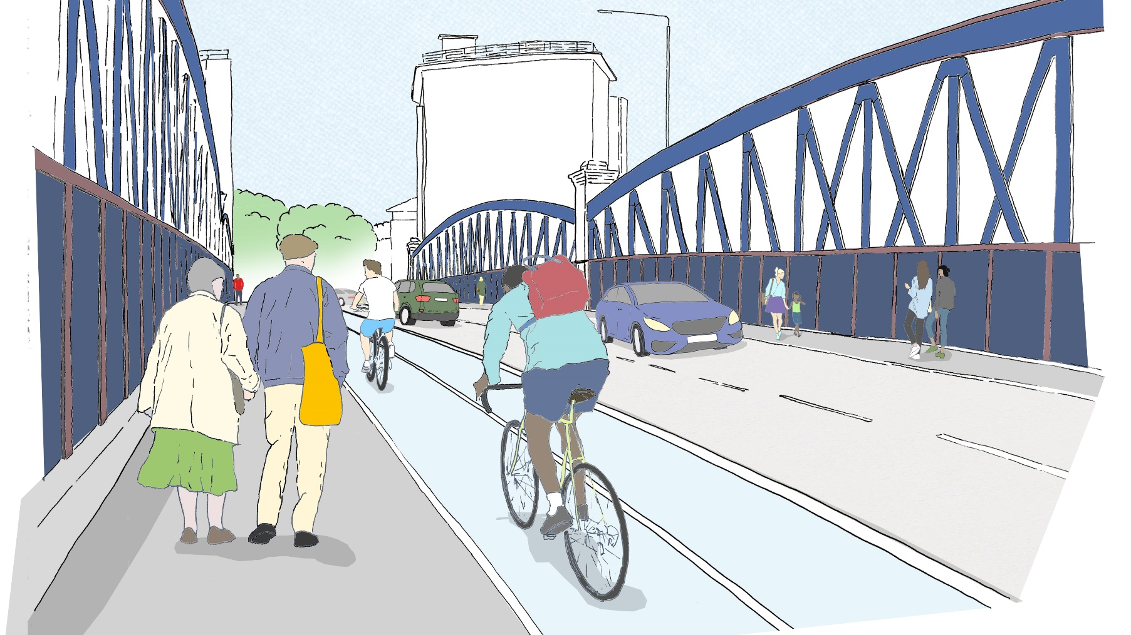
Central Coach Station, London

Slide 23
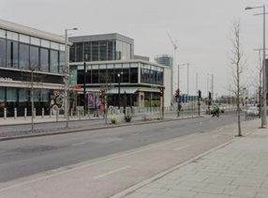
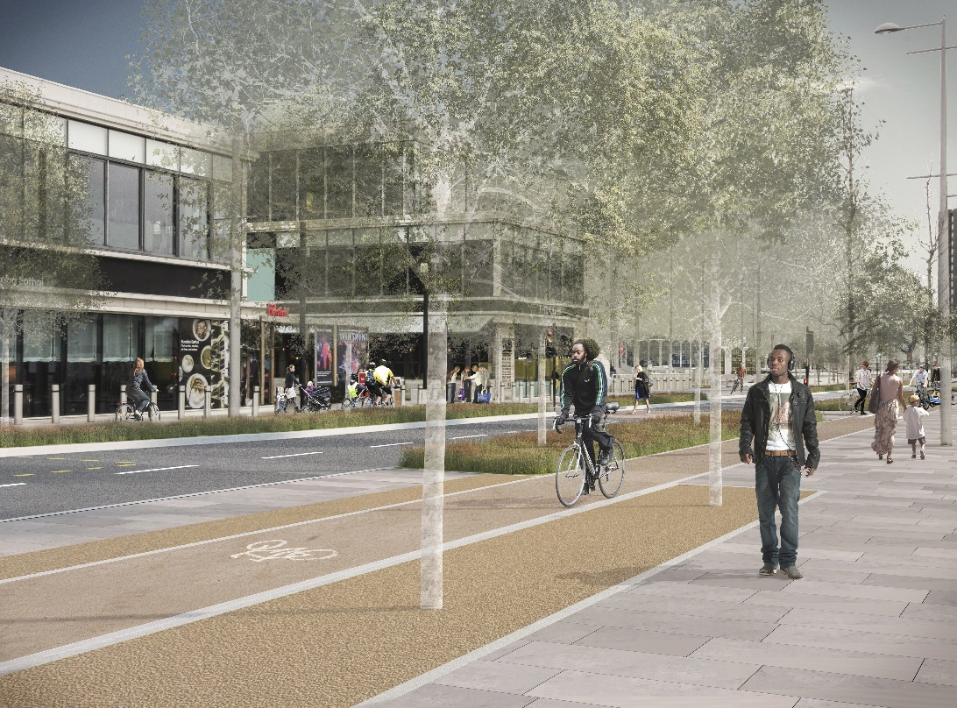
Olympic Park Cycle Masterplan, London
Mott Macdonald asked to develop a Masterplan for downgrading the existing 4-lane highway arrangement to enable introduction of ‘Dutch Style’ cycle facilities
Key design features: cycle superhighway facilities throughout the Olympic Park, significantly improved pedestrian facilities and public realm quality.

Slide 24
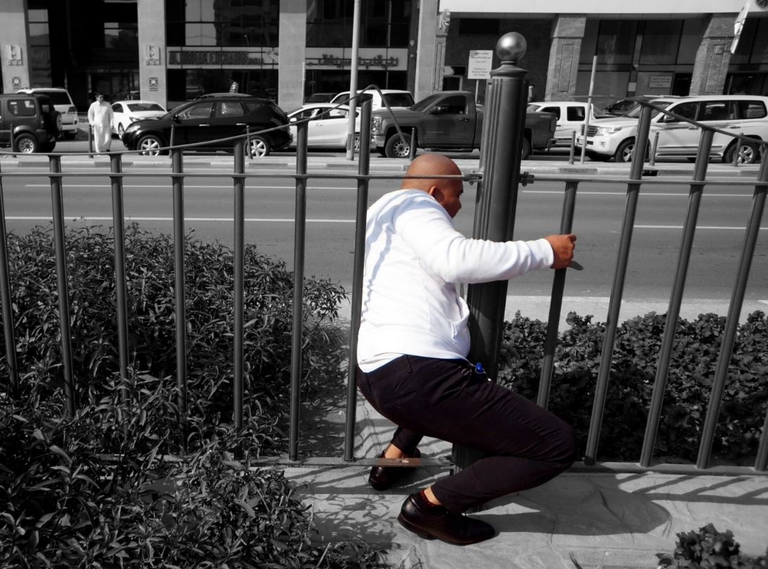
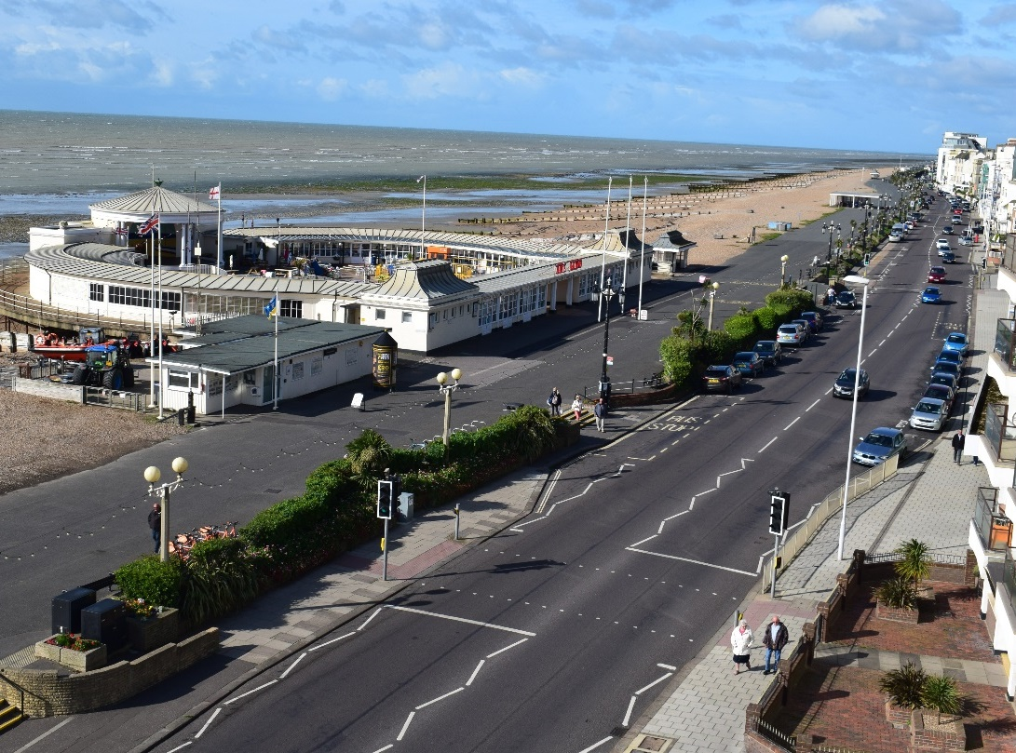
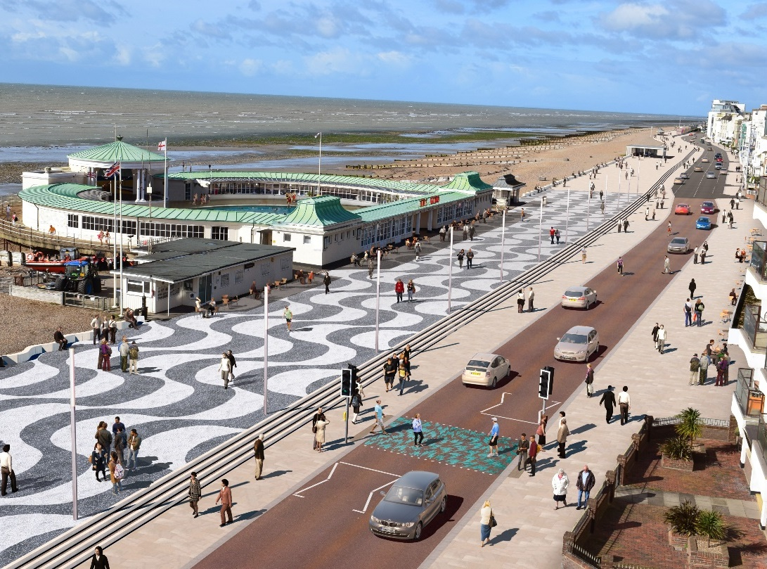
Worthing Seafront Investment Plan
Undertook significant amount of walking and cycling analysis to inform Seafront Investment Plan
Worked closely with local authority and stakeholders to discuss Worthing’s future
Key focus of plan was reconnecting the town centre, train station and Worthing Promenade
Major public realm improvements for the seafront proposed

Slide 25
Seven Dials, Brighton
Historically, Seven Dials = city’s top collision hotspot with a majority of collisions involving pedestrians and cyclists.
Address key collisions points for pedestrians and cycles
Provide an accessible streetscape with focus on de-cluttering
Completely permeable junction
Reinstate the junction as a public space for local communities

Slide 26
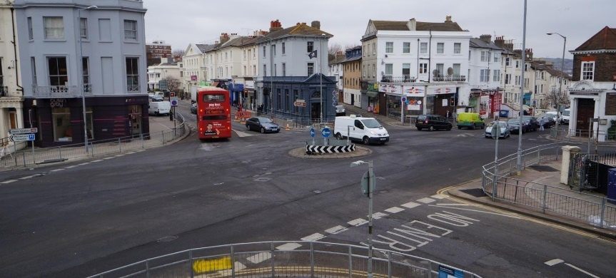
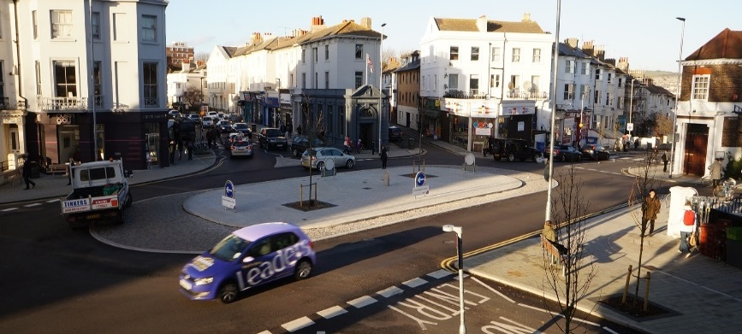
Seven Dials, Brighton

Slide 27
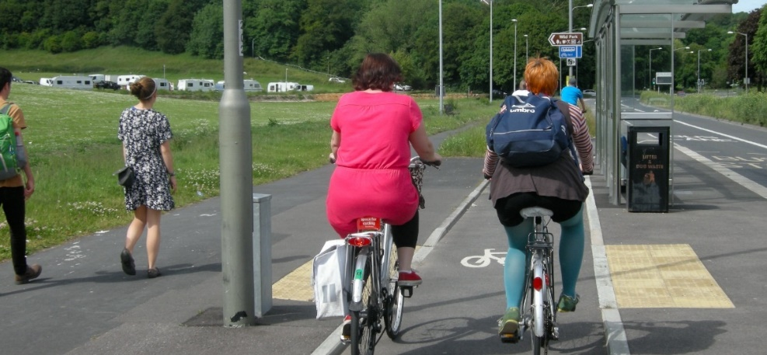
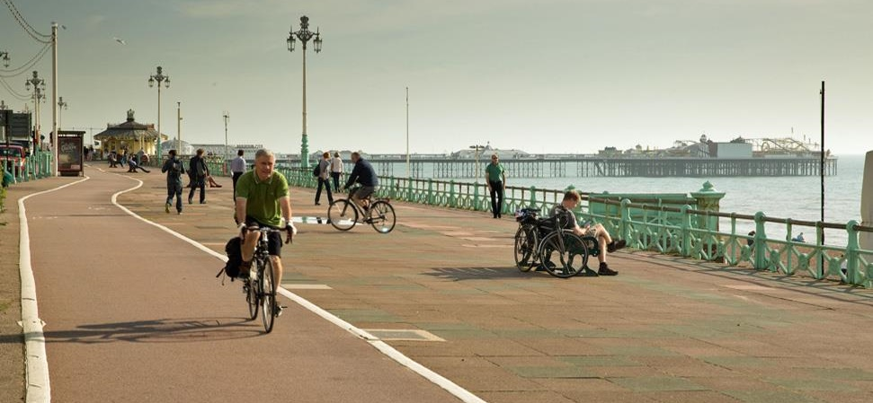
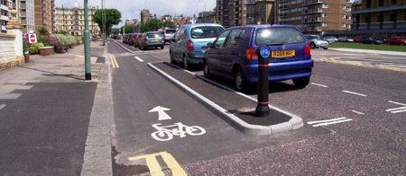
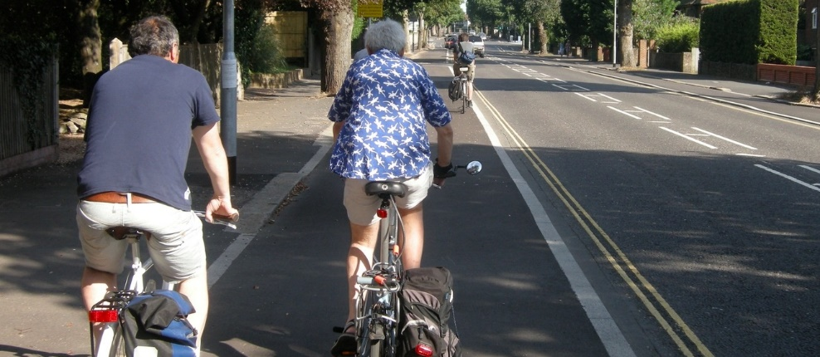
Brighton and Hove City Council – Various Schemes

Slide 28
The time line of the last 2 decades
A 20 year journey of refinement
1990’s
Traffic Director for London & 33 London boroughs
Expansion of London Cycle Network
2008 to 2016
Mayor ‘Boris Johnson’
Roads Modernisation Programme (Cycle Super highways/ mini Hollands
2016 to present
Mayor ‘Sadiq Khan’
Policy: Healthy Streets – further holistic integration
2000 to 2008
Mayor ‘Ken Livingston’
Client Modal Group (Each allocated funding - result schemes overriding one another) Creation of Local Implementation Plans

Slide 29
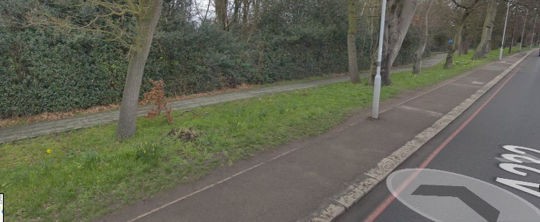
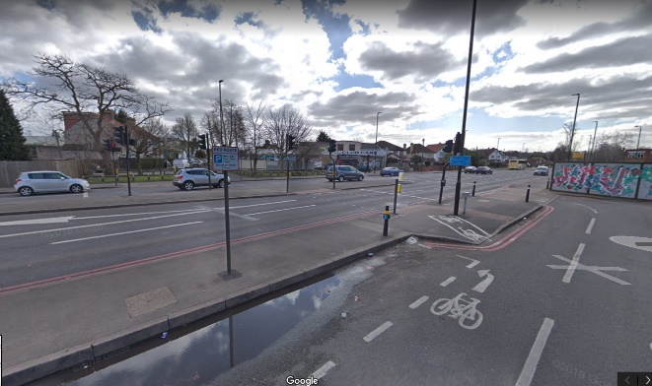
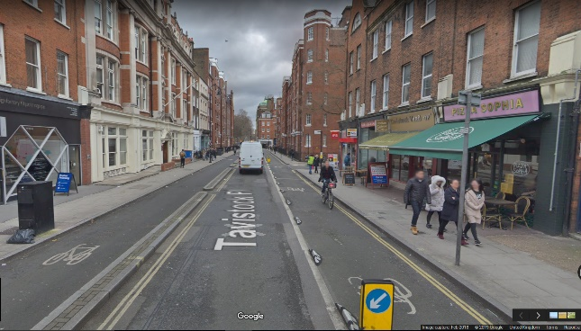
Policy and Planning Guidance from London
A journey through time
During the 1990’s cycling aimed to build on a series of corridors known as the London Cycling network (LCN). What materialised:
The easier segments of the network were implemented (through parks, quieter streets)
The introduction of Toucan crossing to assist crossing difficult traffic dominated arteries
Some progressive authorities, such as the LB Camden and TfL pushed forward to meet the challenge (Cycle mode share when GLA/ TfL created was 1% of all movements in 2000)
…but many locations were proving difficult to develop.
A232 Nonsuch Park, Sutton
A217 St Dunstans’s Hill, North Cheam
Tavistock Street, Camden

Slide 30
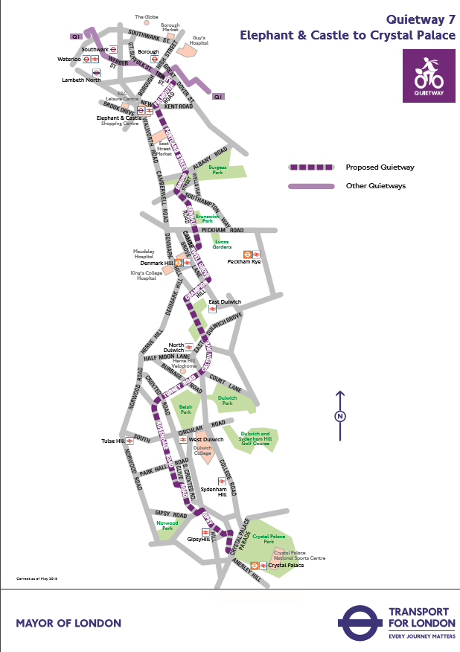
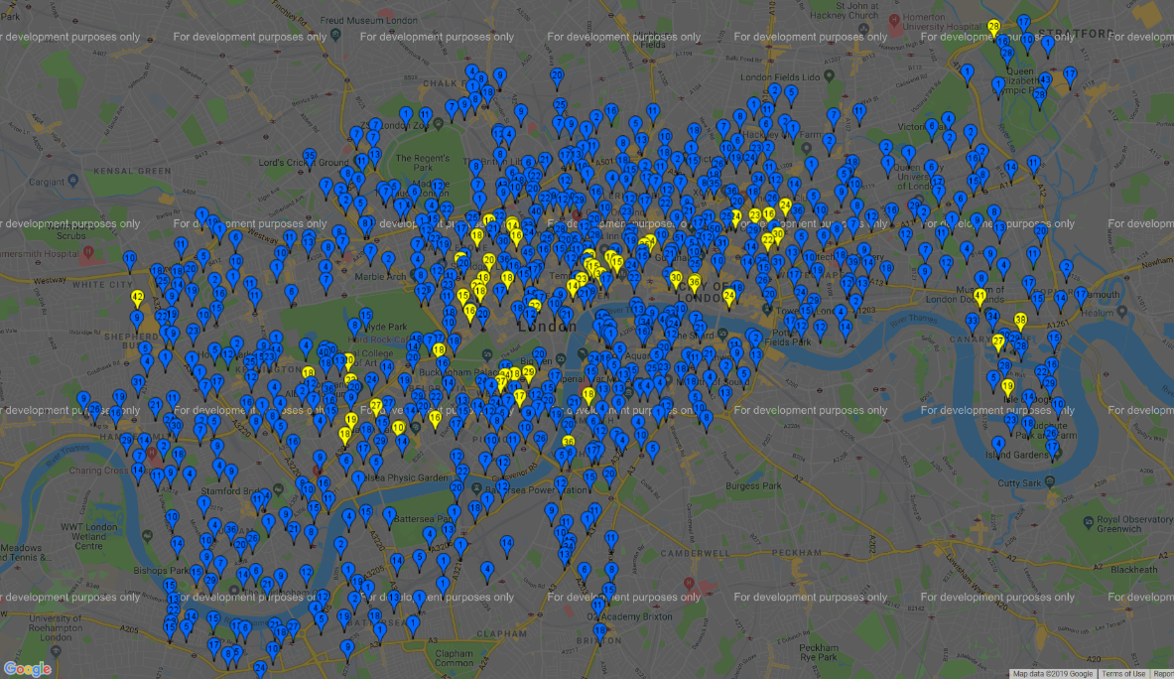
Policy and Planning Guidance from London
CSHR11
The progressive picture – what cycling has offered
London’s population is expanding at approximately 100,000 people per annum (equal to 2 buses/ day)
Research at TfL showed people only change transport mode when key life events occur (birth of children/ economic changes/ change of employment etc.)
By people shift to cycling, creates gaps in a saturated public transport network (e.g. rail and buses). A meaningful benefit for an enhanced integrated transport system
Current ‘Healthy Streets’ Policy has enhanced previous administrations ambitions through encouraging attitudes and providing safer cycling infrastructure (e.g. CSHR2 upgrade) (TfL reviewed and demonstrated reduced costs to NHS and included in Business Cases)
Creation of superhighways was a 3-arm strategy: 12 spoke wheel: collectors/ distributors/ 2 Superhighways to manage high volume central London demand and Quietway's to distribute to/ from these
Creation of Cycle Hire scheme
CSHR2
Central London
EWSCH
CSHR9 (tbc)
CSHR3
NSCS
CSHR4 (2019)
CSHR8
CSHR5
CSHR7

Slide 31
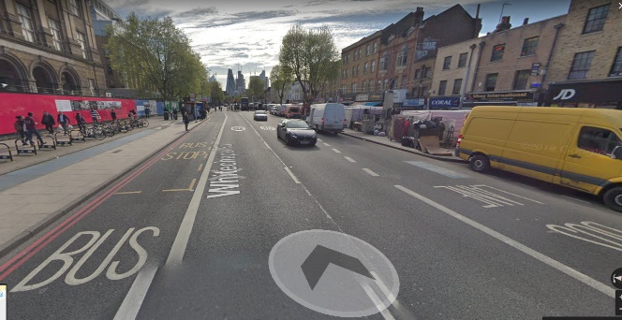
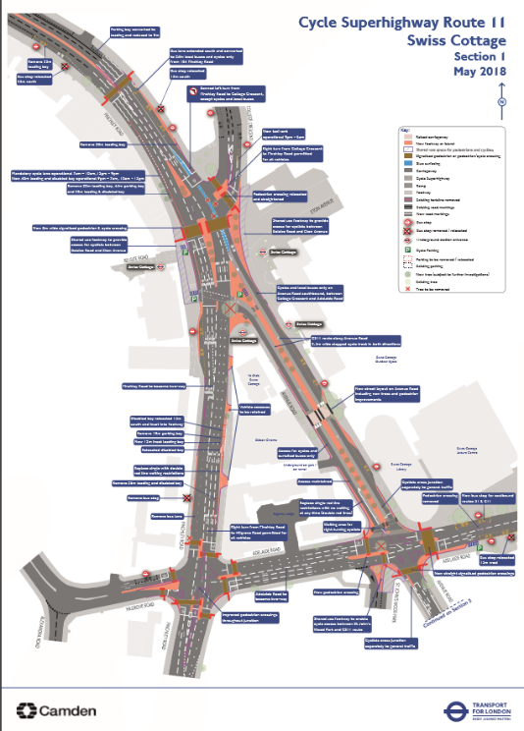
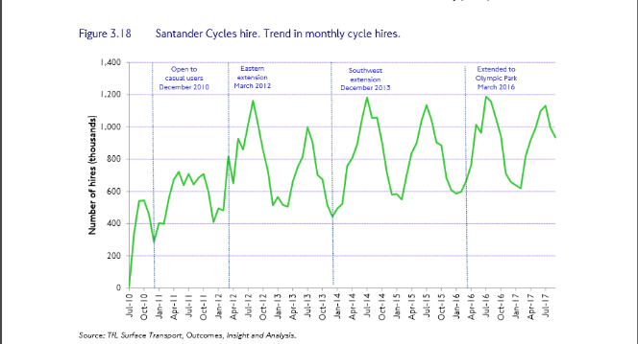
The Superhighways
What the Cycle superhighways introduced
A statement of intent
CSHR2 introduced onto the A11 corridor (urban arteries pre-disposed to traffic, retail, commercial, buses had significant road spaced turned over to cycling)
CSHR2, 3, 7, & 8, were the first: demonstrated a patronage increase of 30% to 300% increase (FYRR). Due to the provision of infrastructure, cyclists willing to migrate up to 800m off their route
White males were the dominant users, but demographic through enhanced facilities is seeing an increase of women and ethnic groups
Evidence shows for every 1ºC, cycle population changed by 2% (neutral months April and Oct). As a result spring summertime traffic signal timing plans started to be introduced
10.5M cycle hires in 2016/17
Corridor upgrades started to be introduced (e.g. CSHR2 and 7). Focus on East London corridors where the growth in housing and opportunity areas has occurred
CSHR2 A11 Whitechapel Road
Cycle hire patronage
CSHR11 Consultation 2018

Slide 32
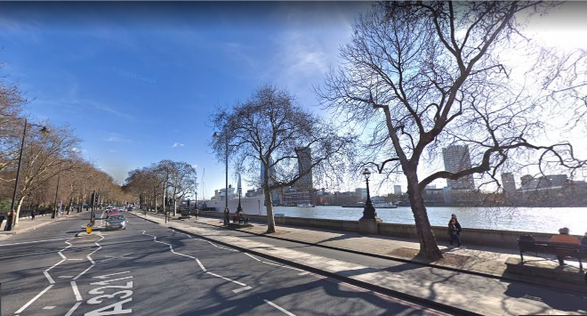
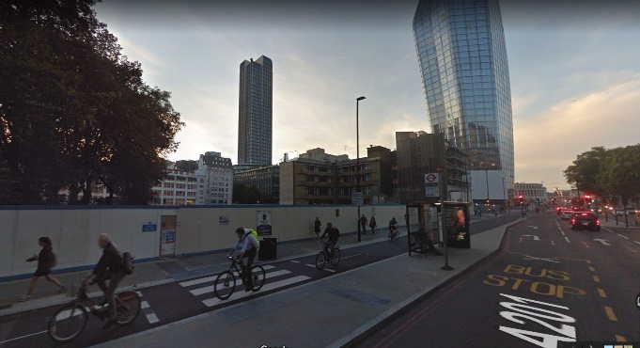
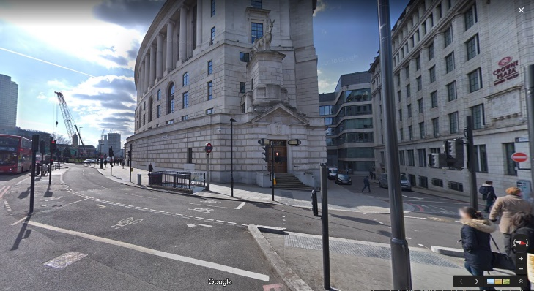
EWCSH and NSCS
The journey continues – Now for the high volume corridors
2012 to 2016 Mayoral Term flagship projects
Spearheaded growth to London mode share of 4% target
Holland and Denmark consulted on approach to high volume cycling (their attitude - conversational cycling e.g. 4 cyclists abreast)
Target for EWCSH was 5m, but 4m the usual track provision (cycle working envelope 1m due to uneven surfaces/ drainage gullies and cyclists not travelling in a straight line) https://www.youtube.com/watch?v=Thyy2-J-BFw
Development of balanced traffic signal scoot network including creation of pedestrian and cycle scoot
Forecast of 3,500/ cycles hour at busiest at Parliament Sq: Reality realised on opening year
Tower Hill to Parliament Sq the central London strategic corridor along with the Inner Ring Road – Accepted that eastbound traffic lane reduced from 2 to a single lane
Introduction of floating bus stops
EWCSH Victoria Embankment
NSCS Blackfriars Road & Farringdon Road
NSCS Farringdon Road

Slide 33
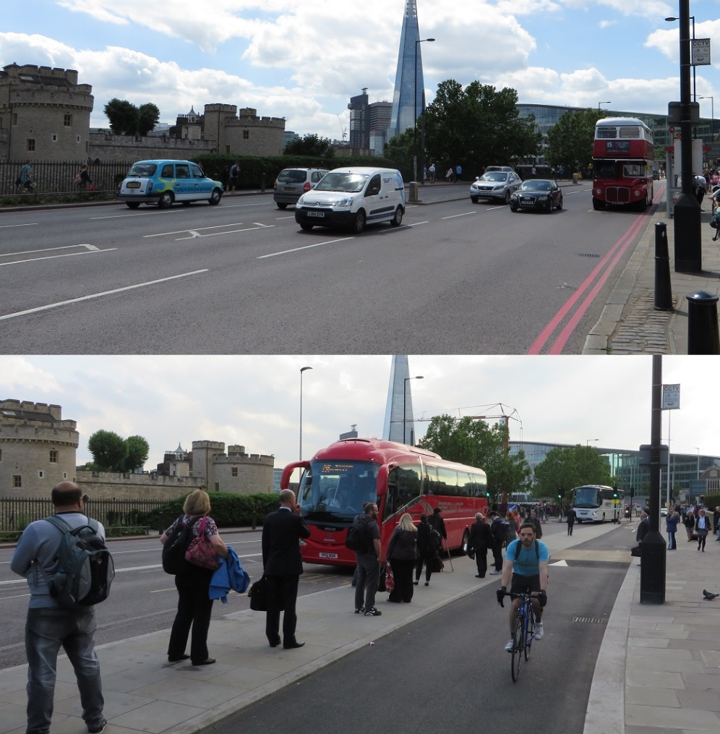
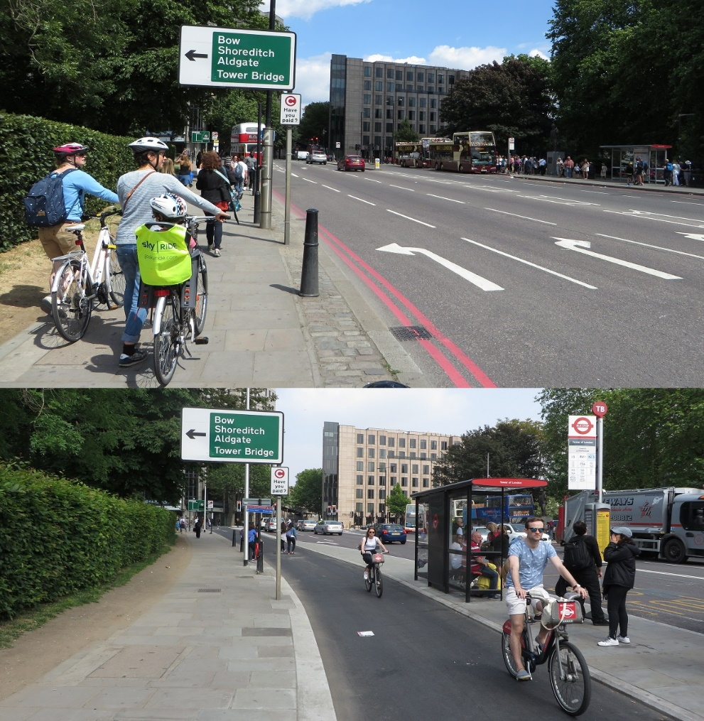
East – West Cycle Superhighway

Slide 34
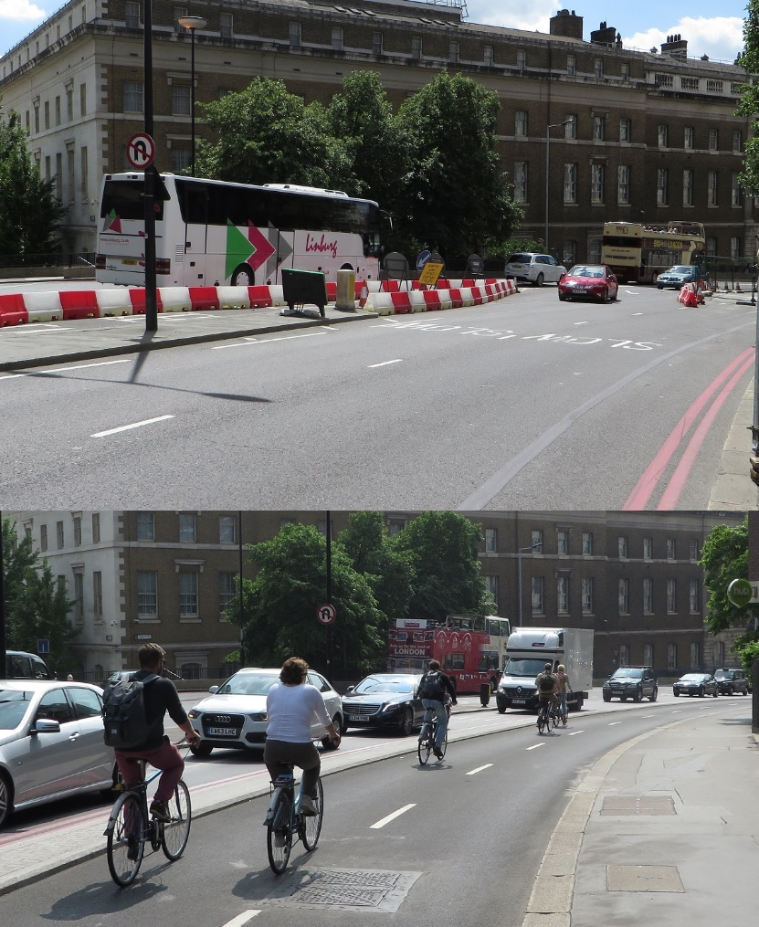
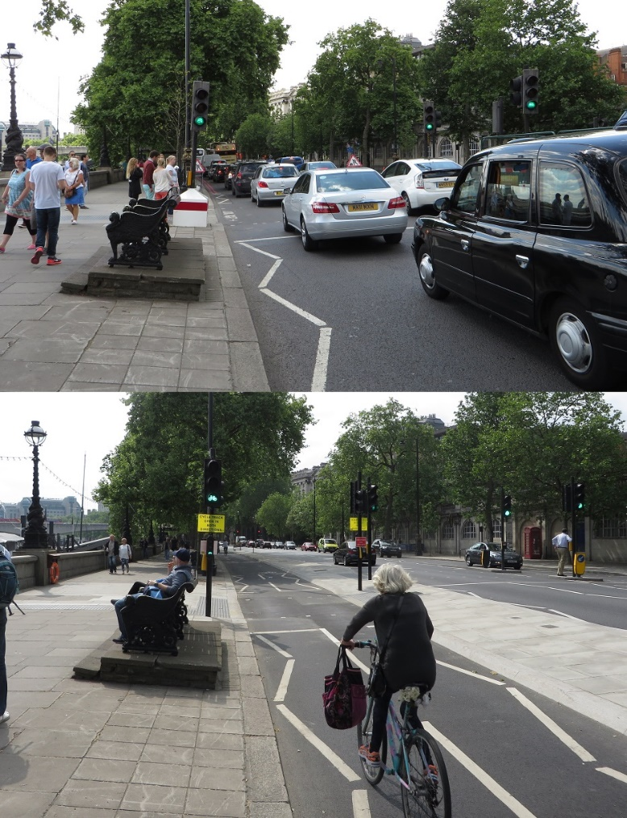
East – West Cycle Superhighway

Slide 35
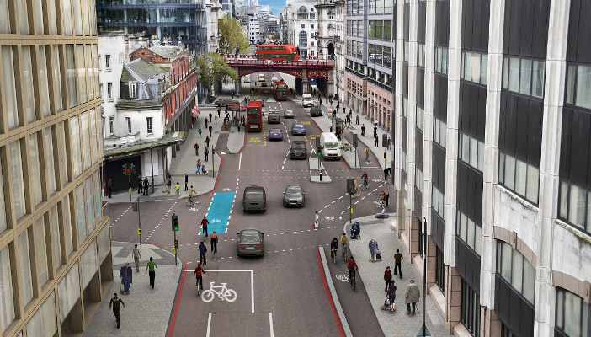
North - South Cycle Superhighway

Slide 36
North - South Cycle Superhighway

Slide 37
The Outcomes
From analysis and post implementation study
Cycle trips stages in London, 730,000/ day in 2016 (2% of all movements) (+8.8% from 2015/16 compared to an average growth of 4.3%/ annum)
For context: Total London daily trips 27.1 Million trips/ day (+1.1%)
Vissim micro-simulation modelling platform enhanced due to genuine cycle-cycle and cycle-vehicle behaviours calibrated – developed for consultation and operations)
Central and Inner London own a much higher cycle volume
With increased patronage has brought a focus to cycle fatalities ( trend of 12-15/annum) with a disproportionate occurrence involving HGVs
Behaviours at cycle traffic signal control – good. Queues of 2-abreast of 20-30 cyclists, with little encroachment into opposing steam. Surveyed reason: Infrastructure for the cyclists exists!
Extract from Travel in London Report 10 (2017)

Slide 38
What could this bring for Douglas and the Isle of Man
Challenges
Topography (In land route selection)
Opportunities
Traffic signal techniques could be used as a policy enhancement capability
Policy & Planning Options
Guidance of likely outcomes
Would a single, or two high capacity corridors be the spine of the network feeding the conurbation?
An enhanced certainty that such corridors would induce migration to/ from them
Development of a strategy that provides dedicated corridors from key demand origins and destinations
Emerging e-bikes becoming more common place
Healthier population
Developing cycle hire (e.g. retail and Inter-changes)
Identification of demographic and district routing
Funding
Population attitudes to cycling
End of destination parking/ facilities
Integration with other modes
The EWCSH Video: The whole route experience : https://www.youtube.com/watch?v=Wvw6zks0Tvk

Slide 39
Douglas Promenade

